Slide 1
Nurse Support Program II
FY 2023 Technical Assistance
Peg Daw & Kim Ford - MHEC
Maryland Higher Education Commission
September 15, 2021

Slide 2
HSCRC and MHEC Contacts
NSP I/HSCRC: Oscar Ibarra, Claudine Williams, and Benjamin Quintanilla
oscar.ibarra@maryland.gov
claudine.williams@maryland.gov
benjamin.quintanilla@maryland.gov
NSP II/MHEC: Peg Daw and Kim Ford
peggy.daw@maryland.gov
kimberly.ford@maryland.gov
Nurse Support Program I and II:
www.nursesupport.org

Slide 3
NSP I and NSP II: Two Sides of the Coin
 | Nurse Support Program I | Nurse Support Program II
What is the program? | Non-competitive grant to hospitals to fund projects that address the individual needs of the hospitals as they relate to nurse recruitment and retention Not intended to fund existing programs that are more appropriately funded through employee fringe benefit programs or to duplicate what is available in rates for traditional hospital-based services or operations | Comprised of two components: Competitive Institutional Grants and Statewide Initiatives Competitive institutional grants fund providers of nursing education Statewide initiatives fund individual students and nurse faculty
What are the goals of the program? | Increase the number of nurses in Maryland through retention and recruitment Increase the number of nurses with higher levels of education Improve the clinical competencies of nurses Elevate the practice of nursing through evidenced-based research | Increase nursing faculty capacity and diversity Expand the education pipeline and address barriers to nursing education pathways Promote innovation in nursing education models
How is the program implemented? | Hospitals are given leeway as to how the programs are implemented, as long as the programs are aligned with the goals of the NSP I program. Some examples of funded programs/initiatives include: Internships/externships for nursing students Scholarships for nurses to pursue advanced degrees Development of nursing leadership and nurse councils Magnet© Journey or Pathway to Excellence© Evidenced-based Practice research | For the Competitive Institutional Grants, Maryland higher education nursing institutions are given leeway as to how the programs are implemented, as long as the programs are aligned with the goals of NSP II. Applicants are encouraged to collaborate, develop partnerships and address current issues in nursing workforce and nursing education. Some examples of funded program/initiatives include: Dual roles for nurse clinicians in teaching and clinical Pathways that fast-track qualified students entering nursing education through community colleges to successfully complete their BSN

Slide 4
Maryland Model
Maryland’s Total Cost of Care All-Payer Model, known as the “Maryland Model,” is a contract between CMMI and the State.
Under the state’s initial five-year contract with CMMI to implement hospital global budgets (2014–18), the state saved Medicare $1.4 billion in hospital spending.
The new Maryland Model was expanded January 1, 2019 and will extend through the end of 2023.
The contract can then be extended for an additional five years, pending a review of the terms.

Slide 5
Innovative Payment Model
Since the 1970’s Maryland has set hospital rates.
While the Commission sets an annual global budget for the hospitals, a fee-for-service payment system remains as the vehicle through which hospitals receive their revenue.
At each hospital, all payers, including Medicare and Medicaid, face the same charge for each service, but the charges differ from hospital to hospital. The Commission provides hospitals limited flexibility to adjust their prices across all cost centers to conform with their global budgets.

Slide 6

Changes with Covid

Slide 7
Important Role of HSCRC
The Commission’s first step was to eliminate any undercharge penalty that would typically apply for a hospital not attaining its global budget at the end of the fiscal year. Second, hospitals were permitted to carry their FY20 undercharge into FY21 and to spread the recapture of that revenue over time so prices would not dramatically increase. Third, as of May 15, 2020, an estimated $500 million in grant money was provided to Maryland hospitals from the federal Coronavirus Aid, Relief, and Economic Security (CARES) Act. These funds were treated as a debit to the undercharge credit, thus reducing by approximately half the amounts that would otherwise be paid by Medicare, Medicaid, and other payers, employers, and consumers through hospital price increases.
Source: 575th Meeting of the Health Services Cost Review Commission, July 8, 2020, page 155.

Slide 8
Impact of Covid on the Model
The state adjusted its policies, in collaboration with Center for Medicare and Medicaid Innovation (CMMI), to successfully respond to the pandemic’s volume impacts and ensure hospitals’ financial stability.
Well positioned in terms of Medicare savings, the state’s performance in CY2019 was the best yet since hospital global budgets were implemented in 2014.
The arrival of COVID-19 in 2020 has been a system test. Maryland has managed the challenges well in collaboration with the CMMI, the hospitals, and other stakeholders, although the ultimate impact of COVID-19 remains to be seen.

Slide 9
NSP II : An Overview
Established in 2005 to increase Maryland’s academic capacity for nursing education
Administered by the Maryland Higher Education Commission (MHEC)
Funded through pooled assessments totaling up to 0.1 % of hospital regulated gross patient revenue
Goal: to increase nursing graduates and mitigate barriers to nursing education through institutional and faculty focused initiatives

Slide 10
NSP II Program Evaluation
Review the NSP II Program Evaluation December 11, 2019
https://hscrc.maryland.gov/Documents/December%202019%20Public%20Pre-Meeting%20Materialsv2.pdf
NSP II Project outcomes-review of initiatives, funding, results
Trends (pre-licensure graduates continued to trend downward)
National nursing workforce projections-nursing shortages worsen & faculty shortages continue
Maryland’s nursing workforce-difficulty accessing MBON data, alternative data

Slide 11
NSP II Program Evaluation- cont.
Hospital concerns-agency nurse use, vacancy rates, turnover
School concerns-clinical site restrictions, lack of clinical sites and decreased # students/rotation
Student concerns-tuition, student debt
NSP II impact on 1. increasing nurse graduates, 2. recruiting/retaining/developing faculty, 3. increasing educational capacity, 4. increasing diversity and underrepresented groups in nursing, and 5. meeting the IOM and NSP II goals

Slide 12
Major Achievements By Initiative 2020
Initiative #1: Ensuring educational capacity for nursing pre-licensure enrollments and graduates
Increased the first time pass rate for NCLEX-RN nursing licensure by 8.51%
Recruited 162 new nurse faculty into full-time positions, maintaining 93% retention rate
Initiative #2: Advancing academic preparation of entry-level nurses and existing nurses to meet the needs of hospitals and health systems (80 percent BSN)
Improved time to completion of Associate to Bachelors in Nursing (ATB) by 50%; estimated cost saving of $13K per new nurse graduate
Increased proportion of BSN nurses to 60% to meet hospital skill mix. (Update: BSN 67%, #4 in the nation)

Slide 13
Major Achievements By Initiative 2020
Initiative #3: Doubling the number of nurses and nurse faculty with doctoral degrees
Increased the number of doctoral degree completions by 78%
Provided funding for 63 full-time nurse faculty to complete terminal doctoral degree while maintaining a 89% retention rate
Initiative #4: Promoting academic/practice partnerships
Expanded NSP II opportunities to 558 hospital-based nurses across 7 programs
Provided focused leadership development for 48 nurse faculty and 89 hospital emerging and existing nurse leaders through the Nurse Leadership Institute
Expanded training for 343 nurse faculty and 51 hospital educators; increasing by 12% the use of clinical simulation in lieu of clinical sites.

Slide 14
Major Achievements By Initiative 2020
Initiative #5: Developing statewide resources and models for inter-professional education, alternative clinical practice sites, and clinical faculty preparation
Established the Maryland Nursing Workforce Center and joined 34 other states in the National Forum of State Nursing Workforce Centers
Updated the Maryland Nursing Articulation Education Agreement (originally established in 1985) for seamless academic progression from Associate Degree Nursing to BSN for Licensed Practical Nurses in 2017.

Slide 15
Competitive Institutional Grants Funding
FY Awarded | Pre-Licensure Nurses | Academic Progression & 80% BSN | Double Faculty w/ Doctorates | Academic Practice Partnerships | Statewide Resources | Cohen Scholars | Total Funding
FY 2016 | $4,646,705 | $8,499,668 | $0 | $8,621,289 | $1,680,097 | $0 | $23,447,759
FY 2017 | $2,136,305 | $7,620,323 | $1,619,142 | $5,758,707 | $431,001 | $0 | $17,565,478
FY 2018 | $946,000 | $8,822,041 | $2,796,513 | $2,370,527 | $2,557,878 | $0 | $17,492,959
FY 2019 | $4,112,164 | $2,035,313 | $902,000 | $2,194,604 | $345,327 | $0 | $9,589,408
FY 2020 | $200,000 | $1,852,583 | $0 | $564,675 | $3,536,189 | $0 | $6,153,447
FY 2021 | $3,402,983 | $1,055,891 | $2,233,535 | $4,656,238 | $5,679,436 | $12,234,314 | $29,262,397
FY 2022 | $1,643,251 | $3,454,165 | $0 | $869,483 | $700,000 | $0 | $6,666,899
Total Funding | $17,087,408 | $33,339,984 | $7,551,190 | $25,035,523 | $14,929,928 | $12,234,314 | $110,178,347

Slide 16
Statewide Initiatives Faculty-Focused Awards
FY Awarded | New Nurse Faculty Fellowship (NNFF) | Nurse Educator Doctoral Grants (NEDG) | Academic Nurse Educator Certification (ANEC) | Nurse Faculty Annual Recognition (NFAR) | Total Funding
FY 2016 | $520,000 | $350,000 | $0 | $0 | $870,000
FY 2017 | $775,000 | $440,000 | $0 | $0 | $1,215,000
FY 2018 | $805,000 | $305,000 | $0 | $0 | $1,110,000
FY 2019 | $885,000 | $470,000 | $285,000 | $0 | $1,640,000
FY 2020 | $1,040,000 | $180,000 | $145,000 | $0 | $1,365,000
FY 2021 | $2,550,000 | $1,470,000 | $195,000 | $130,000 | $4,345,000
Total Funding | $6,575,000 | $3,215,000 | $625,000 | $130,000 | $10,545,000
Total # of Faculty Funded | 265 | 105 | 125 | 13 | 508

Slide 17
Approved Recommendations FY 2021-FY 2025
Recommendation 1: Renew NSP II funding for next five years, FY 2021 through FY 2025 (renewed December 2019)
Recommendation 2: Establish a Workgroup to Recommend Updates to Statewide Initiatives (completed March 2020)
Recommendation 3: Continue Established Competitive Institutional Grants Initiatives #1-5 (continuing FY 2021-2025)
Recommendation 4: Form NSP I and NSP II Advisory Board to Address Common Issues Between Academia and Practice (formed August 2020)
Recommendation 5: Improve Infrastructure for Nursing Workforce Data
(MNWC, MBON, MHEC, HSCRC- ongoing)

Slide 18
Maryland Higher Education Commission (MHEC)
Selected to Administer NSP II
Higher Education Coordinating Board
Expertise in Grants and Scholarships
Receives hospital payments to fund NSP II
Non-lapsing funds-all remain with NSP II
NSP II provides for 1. Competitive Institutional
Grants and 2. Statewide & Faculty focused
initiatives-scholarships, grants, awards, shared
resources.
Annotated Education Code of Maryland [2006,chs. 221,
222][2016]. In 2016, the word “bedside” nurse was removed to
to be applicable to all nurses for NSP I and II.

Slide 19
Foundational Goals
NSP II initiatives are founded on IOM Recommendations:
Increase the proportion of nurses prepared with a baccalaureate degree to 80% by 2020 (goal extended to 2025)
Double the number of nurses with a doctorate by 2020 (goal met)
Ensure that nurses engage in lifelong learning
Prepare and enable nurses to lead change to advance health
Build an infrastructure for the collection and analysis of nursing workforce data (goal met- funded the Maryland Nursing Workforce Center)-see more at https://www.nursing.umaryland.edu/mnwc/

Slide 20
NSP II: Two Aims
Excellence in education and excellence in
practice are the two primary overarching goals.
Increasing capacity at the institutional level through nursing programs
Strengthening nurse educators for an adequate supply of well prepared nurses for the hospitals and health systems.
If someone asks, “What is the NSP II?”
It is a nursing workforce intervention.
It is focused on the Educational Systems while NSP I is a separate
workforce intervention focused on the Hospital Systems.

Slide 21
ROI for NSP II
The return on investment (ROI) of the NSP II funding will be measured through an analysis of baseline and incremental improvements to reach the statewide priorities.
The final analysis focuses on nurse graduate completions, a higher percentage of BSN prepared nurses, more doctoral prepared faculty, meeting the needs of hospitals for a more highly educated workforce, and developing a new cadre of academic and practice leaders.
A true ROI for HSCRC is in a better prepared, capable, and readily available nursing workforce.

Slide 22
NSP I and NSP II Advisory Group
Both NSP I and NSP II fund programs to increase the strength and responsiveness of the nursing workforce. The NSP I and NSP II Advisory Board recognized the intersection of joint goals with the education of nurses to increase the numbers and preparation levels to overcome current and future barriers to capacity.
The areas of nursing leadership, diversity, education, nursing and faculty workforce, resilience and retention of practicing nurses within the recent Future of Nursing: 2020-2030 (2021) report are integral to the goals of NSP.
Nurse retention and turnover costs are the next priority concerns to be addressed by the NSP I and NSP II team.

Slide 23
NSP II measures entry level RNs
HRSA continues to explore systematic
differences in state-based administrative data
and analyze how each model handles entry to
practice output. In fact, all researchers agree
that “co-monitoring changes in RN entry is the
single most important factor that affects each
model and hence accuracy of its projections”
(Auerbach, et al., 2017, pg. 294).
NSP II will report on NCLEX-RN pass/entry level
figures and expects you to increase # new RNs.

Slide 24
Nursing Supply vs. Demand
The State cited with the nation’s best nursing
supply vs. demand balance utilized three best
practices: 1) funding a permanent nursing
workforce center to study the state level
dynamics, 2) expanding enrollments in nursing
programs, and 3) providing incentives for
newly licensed nurses who practice in facilities
for more than two years after graduation.
(Zhang, X, et al., 2018)

Slide 25
Mandatory Dissemination
Required-to be planned and funded ($) each
year. It must be included in all annual/final
reports.
What happens if Mandatory Dissemination is
not budgeted or completed?
Use of funds cannot be approved- current or
remaining funds requested in carryover.
It is one of TWO MAJOR requirements.
Mandatory Data Tables
Mandatory Dissemination

Slide 26
Mandatory Dissemination
Publication Citations
Daw, P., Ford, K., Seldomridge, L. & D’Aoust, R. (2021). Increasing Faculty with CNE® Certification: A Statewide Initiative, Nursing Education Perspectives. (Accepted for Publication)
Jarosinski, J., Seldomridge, L., Reid, T. & Hinderer, K. (2020). "Learning how to teach" in nursing: Perspectives of clinicians after a formal academy. Nurse Educator, 45(1), 51-55.
Presentations
MNA Education Summit 4.17.2021
NSP II PPT
NSP II Project Director's Meeting: October 16, 2020
https://nursesupport.org/nurse-support-program-ii/dissemination/

Slide 27
Mandatory Dissemination
2021 Maryland Action Coalition (MDAC) Virtual Leadership Summit
Meeting Challenges Head On: Maryland Nurses Respond offered virtually
Monday, May 24, 2021
The Maryland Action Coalition (MDAC) is an ideal venue to complete your annual NSP II project mandatory dissemination activities, which are important for synergy and collaboration to demonstrate the return on investment in programs, nurses and faculty. *Special thanks to the NSP II Project Directors and Staff for Dissemination through Podium or Poster presentations.
May 24, 2021 MDAC Podium and Poster Presentations
1. A Collaborative Performance funded by NSP II: XX-XXX
https://nursesupport.org/nurse-support-program-ii/maryland-action-coalition/

Slide 28
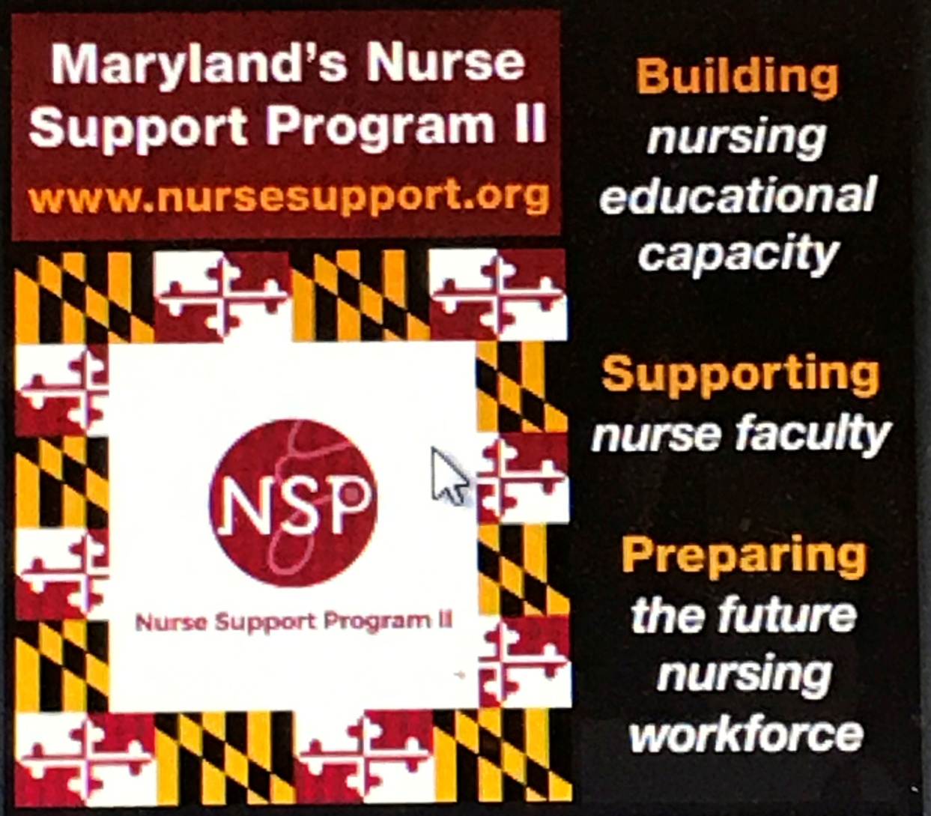
Maryland Nurses Association

Slide 29
National and State Conferences
Other Examples:
Sigma Theta Tau
AACN
NLN
NPAM
DNP
OADN and more
Posters and Podium presentations encouraged
Citations required with date/location/topic of
Presentation, along with a copy of materials
Submit citations with each annual report
Cite all dissemination on the Final report
Out of state travel is funded/allowed on limited basis if accepted
presentation on the NSP II project work

Slide 30


Academic Nurse Educator Certification (ANEC)
NSP II Requires
ACKNOWLEDGMENT
Rita F. D'Aoust, PhD, ANP-BC, CNE, FAANP, FNAP, FAAN
School of Nursing, Johns Hopkins University, Baltimore, MD, USA
abstract
results
This research evaluates one of the Nurse Support Program II’s (NSPII) outcomes for a state initiative to advance certification of nursing faculty.
Faculty reported chief barriers were uncertainty in eligibility, personal preparation burden, test anxiety, financial reimbursement and the investment required for the ongoing professional development requirements to maintain the credential.
ANEC Annual Award Incentive Outcomes by removing barriers, assisting personal strategies, and providing incentives
  131 faculty participated in CNE Examination reviews
  36 new CNE certifications and 21 CNE renewals in FY 2020
57 full time nursing educators received the ANEC Awards for new and continuing CNE certification
background
Research on CNE certification examination results (Byrne & Welch, 2016), and retrospective analysis of first- time unsuccessful attempts (Lundeen, 2018), identify exam preparation strategies, incentives, and rewards. Strategies and incentives include individually created timelines, formal direction from nursing education leadership and personal faculty investment.
Faculty reported chief barriers were uncertainty in eligibility, personal preparation burden, test anxiety, financial reimbursement and the investment required for the ongoing professional development requirements to maintain the credential.
To address these issues, the Maryland Council of Deans and Directors of Nursing Programs recommended the NSP II staff coordinate CNE Workshops in conjunction with the NLN Program Department.
References
conclusions
Altounji, D., Williams, S., & Secola, R. (2019). Inspire certification among pediatric hematology oncology nurses. Journal of Pediatric Oncology Nursing. https://doi.org/10.1177/1043454219845892
Barbé, T., & Kimble, L. P. (2017). What is the value of nurse educator certification? A comparison study of certified and noncertified nurse educators. Nursing Education Perspectives, 39(2), 66–72. https://doi.org/10.1097/01.NEP.0000000000000261
Barbé, T., & Kimble, L. P. (2018). A factor analysis of the perceived value of certification tool for nurse educators. Nursing Education Perspectives, 39(3), E2-E6. https://doi.org/10.1097/01.nep.0000000000000300
Byrne, M. M., & Welch, S. (2016). CNE certification drive and exam results. Nursing Education Perspectives, 37(4), 221–223. https://doi.org/10.5480/14-1408
Lundeen, J. D. (2018). Analysis of first-time unsuccessful attempts on the certified nurse educator examination. Nursing Education Perspectives, 39(2), 72–79. https://doi.org/10.1097/01.NEP.0000000000000276
Nurse Support Program II, Academic nurse educator certification (ANEC) award (2019). https://nursesupport.org/nurse-support-program-ii/grants/statewide-initiatives/academic-nurse-educator-certification/
Simmons, L. E. (2017). The NLN’s Certified Nurse Educator (CNE) Program Has Surpassed 5,000 and Gone Global. Nursing Education Perspectives, 38(2), 110. https://doi.org/10.1097/01.nep.0000000000000125
objectives
Develop incentive model and fund a new faculty focused grant program to facilitate new and maintenance of certification - the Academic Nurse Educator Certification (ANEC).
Evaluate outcomes based on the Perceived Value of Certification Tool for Nurse Educators (Barbé & Kimble, 2018)
The ANEC program (NSP II, 2019) has increased the number of faculty with the CNE credential and has increased the number of certified academic nurse educators in Maryland by 55%.
The ANEC program is a state initiative that demonstrates an increase in the number of certified academic nurse educators, provides formal recognition, facilitates preparation and maintenance, and provides financial incentives for new and continuing CNE certifications. An increase in intrinsic value is expected through individual accountability and pursuit of excellence as faculty achieve certification in their specialty area of practice.
Academic-State partnerships improve excellence in nursing education
methods
The Perceived Value of Certification Tool for Nurse Educators (Barbé & Kimble, 2018) used as a program evaluation framework for ANEC sample characteristics, certification out comes, program satisfaction, and a survey used to gather information on incentives, barriers, and personal strategies used by ANEC recipients on their certification journey.
The ANEC program was developed with and disseminated across 28 nursing programs in Maryland through:
  National League for Nursing approved CNE Examination workshops to Maryland educators
  ANEC incentive and recognition award
Conduct CNE Workshop surveys after each workshop
Conduct 3 CNE certification status surveys
acknowledgements
REMEMBER
Funding support provided by NSP II through the Health Services Cost Review Commission, administered by the Maryland Higher Education Commission
Maryland Council of Dean and Directors of Nursing Programs
Notes:
To change this poster, replace our sample content with your own. Or, if you'd rather start from a clean slate, use the New Slide button on the Home tab to insert a new page, then enter your text and content in the empty placeholders. If you need more placeholders for titles, subtitles or body text, copy any of the existing placeholders, then drag the new one into place.

Slide 31
Key Items on Cover Sheet
Lead Applicant Institution/Organization: Your School’s Name
Project Title: Be brief (6 words or less)
Partnership Members: Include your hospitals and fellow nursing program partners (partners are an important ++++)
Please make sure cover sheet is signed by President, VP or Dean/Director of Nursing-NOT the project director.
Please list a name and contact information under PD, Grants Office, and Finance/Business office. These are the names we use to send official grant documentation and invoices.
Project Duration: 1-4 yrs (Outcomes by August 31, 2024.)
Funding Requested: be realistic-$10mil is divided among 28 programs
Value of Match (Funds, In-Kind, Etc.): Required
If projects submitted with -0- match and-0- in Kind, there is no rationale
or reason to help fund a Project the school finds no value in.
If the exact project or something similar has already been funded in prior years,
a good explanation is needed on continued support. Continuation grants are
invited based on the outcomes and impact on the State’s resources.

Slide 32
Pick One*: Type and Initiative
*Type of Grant: (choose only one): ☐Planning ☐Implementation ☐Continuation ☐Resource Grant
*Type of Competitive Grant Initiative: (choose only one):
☐1. Initiative to Increase Nursing Pre-Licensure Enrollments and Graduates
☐2. Initiative to Advance the Education of Students and RNs to BSN, MSN, and Doctoral Level
☐3. Initiative to Increase the Number of Doctoral-Prepared Nursing Faculty
☐4. Initiative to Build Collaborations between Education and Practice
☐5. Initiative to Increase Capacity Statewide
☐6. Initiative to Increase Cohen Scholars as Future Faculty and Clinical Educators

Slide 33
#5 Statewide Capacity Programs
Maryland Clinical Simulation Resource Consortium (MCSRC) at Montgomery College Train the Trainer (SEL, ASEL), Video Scenarios
https://www.montgomerycollege.edu/academics/departments/nursing-tpss/nursing-simulation-scenario-library.html
Nurse Leadership Institute at University of Maryland (NLI)
https://www.nursing.umaryland.edu/academics/pe/nli/
Faculty Academy and Mentorship Initiative (FAMI) at Salisbury University
https://www.salisbury.edu/academic-offices/health-and-human-services/nursing/fami-md-academy/
Maryland Nursing Workforce Center (MNWC) at University of Maryland
https://www.nursing.umaryland.edu/mnwc/ (NGN, Universal Onboarding)
Renewal, Resilience and Retention (R3) at Johns Hopkins University
https://nursing.jhu.edu/faculty_research/research/centers/R3/index.html?utm_source=r3_website&utm_medium=shorten_url&utm_campaign=shorten_url_fy22&utm_term=marcom&utm_content=r3_website
Lead Nursing Forward (LNF) at Salisbury University
https://www.leadnursingforward.org/ (Educator Openings)

Slide 34
Projected and Actual Outcomes
Projected Outcomes: (Identify below the number of additional outcomes)
Proposed/ Final Outcomes Projected Increase (# of Additional Graduates) Describe Degrees/Results
Nursing Pre-Licensure Graduates ________________
Nursing Higher Degrees Completed (describe) _______________
Nursing Faculty at Doctoral Level _______________
Collaborative or Statewide Results (specify) ________________
What you enter in the proposal- is tracked with annual/final reports.
It is measured in the project analysis as: “met OR not met” in the Final report.
If there is no reasonable chance of meeting these numbers, the proposal may
not be funded or the project extended if the objective numbers do not support.

Slide 35
Panel Review Process
The proposal narrative must be limited to a maximum of 15 single-spaced pages. All required pages for scoring the proposal must be within this limit.
Pages must have one-inch margins and be in Times New Roman 12 font.
Pages must be 8 ½ by 11 inches in size.
Title should be brief (less than six words).
All proposal narrative pages must be numbered.
Key information should be present on the first page and supported in proposal.
Appendix material must only include relevant information like Mandatory Data Tables, CVs, etc. (The appendices do not count in the 15-page proposal limit.) We will count 15 pages: cover sheet to budget- disqualified if not present.
One signed original proposal and nine two-sided copies must be submitted to MHEC to limit the package size mailed to the review panel.
No Binding- use paper clips or binder clips on the left top corner.
In addition, electronic proposal applications, electronic excel budgets, and electronic PPT-no more than 5 slides that summarize the proposal and anticipated outcomes must be submitted to MHEC by the due date. Forward these to: peggy.daw@maryland.gov and kimberly.ford@maryland.gov.

Slide 36
Line Up of Proposal’s 15+ pages
Cover Sheet: (Required) (2 pages)
Abstract: (5 Points) and PPT-no more than 3-5 slides that summarize the proposal and anticipated outcomes (3 pages)
Table of Contents: (Required) (1 page)
Proposal Narrative: (75 Points) (Proposal Narrative is limited to 15 single-spaced pages)
  Overview of Proposed Initiative: (15 Points) (FIRST PAGE CRITICAL)
  Project Goals and Objectives: (15 Points) (REPORTING PLANS)
  Scope of Proposed Initiative (Plan of Operation ‘s ): (15 Points) (SUCCINCT)
  Management Plan: (15 Points) (Who/What/When/Where/How to achieve above)
  Evaluation Plan: (15 Points) (OUTCOMES-MEETS or DOES NOT MEET)
Budget and Cost Effectiveness: (20 Points) (usually 5-10 pages maximum)
(Mandatory Data Tables Appendix A- place after the Budget Documents)
Additional key items (MOUs, Assurances, Brief Bios, new Job Descriptions- reviewers are volunteers)

Slide 37
Data Definitions and Sources
MDT for all NSP II Grant Applications
The NSP II Program Evaluation Team in 2014 and again in 2019 continue to endorse the use of these metrics.
Previous performance funding described a broad set of policies linking allocation of resources to accomplishment of certain activities.
Outcomes based funding is more specific. It is based on a significant stable funding source, and considers completion of the projected outcomes as a primary metric with priority given to reaching underrepresented groups in nursing and increasing highly qualified nurse faculty.
Maryland’s Deans and Directors of Nursing Programs defined the metrics for NSP II’s mandatory data tables. All of this information is readily available in routine annual reports completed by the nursing programs for either the MBON or accrediting bodies and submitted by the nursing program.
Definitions for Mandatory Data Tables in Appendix A
(Required Data Set for all Programs)

Slide 38
Mandatory Data Tables
Nurse Support Program II FY 2023 – Competitive Institutional Grants
Mandatory Data Tables
Required Data Set for all Programs
Faculty: Calculate FTEs using the following formula: FTE calculation: 1 FTE = 15 credits or 600 hours per semester or as defined by your institution for Nursing Program Faculty as of October 15th of the most recent year.
NURSING FACULTY As of Oct. 15, 2021
Equivalents (Total FTEs)
FT
PT
Total Number
Nursing Faculty with PhD in Nursing
Clinical Nursing Faculty with MS Pg 41, RFA, FY 2023

Slide 39
Important: # of Graduates
# Graduates per academic year (as appropriate) Define AY reported: __________
ADN
BSN
Master’s Entry
RN-BSN
RN-MSN
MS
DNP
PhD
Graduates
We expect to see “additional graduates”. This is the baseline year and you will
propose increasing with the grant funding proposal.
RFA, FY 2023, Pg. 43

Slide 40
Person completing Data Tables
Note: The Dean/Director or designee already submits this information to the MBON and accrediting bodies each year. We expect it to match. Any questions, refer to your Dean/Director of the nursing program.
Name of person completing Mandatory Data Table Form:
_______________________________________________________________
Institution:
_______________________________________________________________
Contact Info:
Phone:
____________________________________________________________
Email address:
____________________________________________________________

Slide 41
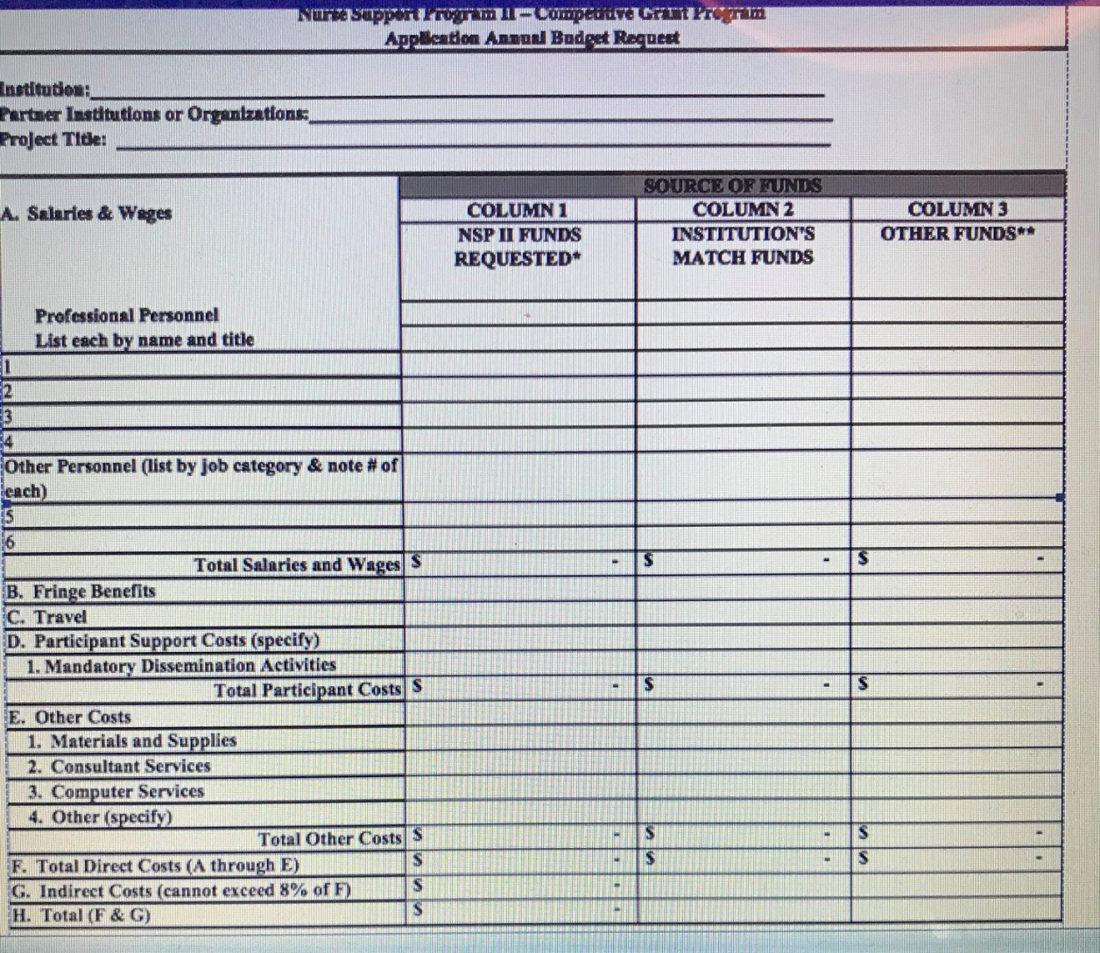
Budgets- Annual and Total Years

Slide 42
Budget Narrative
SAMPLE BUDGET NARRATIVE (annual reports should include narratives that match the proposal)
Nurse Support Program II – Competitive Institutional Grants
Lead Institution: _______________________________________________________
Project Title: __________________________________________________________
(These partial examples are provided only to demonstrate the format requested for the budget narrative. This is an annual and final report requirement. Please match proposal with future reports to ensure descriptions align.
Salaries & Wages
Professional Personnel:
Column 1: Dr. Jill Smith, the project director, will spend 10% of her time in project activities during the academic year. Maryland State University requests only the amount it will cost the university to pay an adjunct to replace Dr. Smith in one course. Request = $4,900 (In-kind: university will pay $____ of salary)
REQUIRED WITH ORIGINAL PROPOSAL, EACH ANNUAL REPORT, FINAL REPORT and/or Project Amendment with a budget change

Slide 43
Budget Information
· Proposals must include a detailed budget for each year for which funds are requested, as well as a total budget for the entire project.
· Budgets should identify in-kind contributions and matching funds, if applicable.
· Primary funding is focused on nurses, nurse faculty, and clinical instructors-this is an education funded program to provide for newly licensed nurses and to prepare nurses with higher degrees for a pipeline to sufficient faculty and educators to teach additional students.
· Funds may be used for salaries, technology, supplies, instructional equipment, travel, and other direct expenses essential to the conduct of the initiative.
· Each grantee should build funding into the budget to attend Mandatory Dissemination Activities and programs each year. Please consider that these meetings could potentially take place anywhere in the state or across the nation. The grantees should take that into consideration when budgeting for travel, hotel, registration, and per diem costs for poster and podium presentations required each year.
RFA p. 23

Slide 44
Ineligible Costs New Proposals
Existing programming; Non-instructional equipment; Marketing;
Clinical Simulation or Virtual Reality equipment, materials, supplies, PPE, high fidelity or other manikins; Standardized patients;
Duplicating previously funded projects;
Student retention/academic success;
Construction and renovation of facilities; phone lines;
Capital equipment for new facilities, ex: furniture
High school student programs;
Student supplies and materials required by the program, ex: textbooks;
Student funds for electronic resources or reimbursements for testing, ex: HESI, Kaplan, ATI, Nurse Tim, UWorld, Review Courses, licensure, and other student fees
Tuition (allowable in the Cohen Scholars program);
Entertaining (excludes light fare or luncheons for faculty recruitment sessions, professional development sessions, conferences, etc.) These are considered the responsibility of the institution. If required for the project,
put the amount of money you will use in the column for in-kind/institutional match.
Existing older proposals may not request use of remainder funds for these items.
RFA pg. 23

Slide 45
Responsibility for the Budget
The project director needs to review the budgets prepared by grant/finance staff and make any reductions prior to submission. Note: The budget and cost-effectiveness will be evaluated on the extent to which:
the budget is adequate to support the faculty needed for the project;
the costs are reasonable in relation to the objectives and design;
the budget shows self-sufficiency and gradual increase in the support provided by the school by the end of the project if the programs continue;
there is adequacy of support—including facilities, equipment, supplies, and other resources—from the partners;
administrative costs and support staff are kept to a minimum;
Limit the use of “Other”. If there is a line item that we have not included, there is a reason. Marketing should be done by the school, so include it in institutional match.
Be thoughtful on the original budget needs- any minor changes are for one year only……….. if approved by NSP II staff.
Reallocations will be limited in FUTURE, as they should be minor and minimal
RFA p. 24

Slide 46
Start with a tight budget
NSP II Review Panels WANT to fund as many of
the proposals as possible.
This past year, they approved 7 competitive
institutional grant awards. Abstracts listed here:
https://nursesupport.org/nurse-support-program-ii/grants/competitive-institutional-grants/
If we can see where to cut your budget and the
Panel can see where there is excess, then you
can too. Don’t send it in, unless you want to
give up your chance to be funded. Excess budget
will disqualify your work just like late submission.

Slide 47
Annual and Final Reports
Reminders:
1. Projected/actual outcomes table matches original
2. Dissemination must be cited on pg. 2 right after the proposed/actual outcomes tables. Evidence of the submission-title of the poster/presentation on an agenda- copy of abstract/poster/letter included. Funding for dissemination is to be budgeted/spent every FY-it is not acceptable to be -0- in any budgets.
3. Mail original double-sided narrative and budget report with original signatures to the NSP II office. Send one report via email to peggy.daw@Maryland.gov & kimberly.ford@Maryland.gov from the Project Director, cc: others- with NSP II xx-xxx in subject line. PDF of entire annual report with all narrative and budget forms & separate Excel spreadsheet of Annual Budget Summary
4. Submit a project & budget amendment form IF you are in the extension period-(the forms you used for extension are N/A for carryover- just an estimate-new forms required with annual report for use of funds as “carryover” to match the annual $$ or asking for eligible carryover.

Slide 48
Carryover limited < $50K
Situations where carryover is disallowed include:
Late reports without prior notification and written permission;
Overestimated the first year of the budget without hiring expected personnel in a timely manner;
Greater than $50,000 in funds remaining at the end of the fiscal year (entire amount cannot be requested for carryover- $$ to be returned or subtracted from the next fiscal year’s planned payment invoice);
Did not submit mandatory data tables;
Did not complete annual mandatory dissemination and submit supporting citations and materials (one page sample of poster);
Project is not meeting proposed outcomes and has no likelihood of success either through overstatement of proposed outcomes or unexpected changes in the institution.
The Carryover process is not a time for major reallocations in new line items not previously approved in the original proposal.
RFA Pg. 30

Slide 49
Excessive Carryover Guidance
NSP II Project remaining balances at the end of a FY that are greater than $50,000 cannot be used in the next FY. The goal is to achieve a rebalancing of the project funding. The next FY is sufficient for the project.
Example: If funds in excess of $50,000 remain, those funds may be approved to remain at the school to begin your approved FY 2022 budget pending any additional funds for FY 2022. The annual reports are due 8/31. As soon as NSP II receives and approves your annual report, a formal letter describing the process and an invoice for the difference between the remaining funds on the report and expected FY 2022 payment was released by MHEC. This ensures projects continue uninterrupted and the funds are at the institution for the original approved FY 2022 budget. The carryover amount is deducted from the original award for FY 2022.
Ex: If less than $50,000 in funds remain, you must submit project and budget amendments to request the use of carryover funds in FY 2022. If approved, funds may be kept going into FY 2022.
Ex: If greater than $50,000 in funds remain, you will not be able to use any of them and plans to deduct them from FY 2022 or leave them to be returned at the end of the grant due to the amounts is communicated.
New Line Items are Reviewed Closely. The Goal is to Follow the Original Approved Budget. Faculty and Instructors are the chief funding purpose for all NSP II grant projects.

Slide 50
Grant Extensions
Grantees must also request written approval to extend the expiration date of
the grant if additional time beyond the completion of the approved activity
within the funds already made available. A single extension, which shall not
exceed six (6) to twelve (12) months, requested no less than one month prior
to the originally established expiration date or May 31st.
The request must explain the need for the extension and include
an estimate of unobligated funds remaining and a plan for use.
The fact that unobligated funds may remain at the end of the
Fiscal Year or at expiration of the grant is not in itself sufficient
justification for carryover or an extension. It must be goal related
and include an outcomes table with actual outcomes and a clear path
to reach or exceed the number of original graduates or major promises.
If an extension is granted, include the letter with the annual report
and complete the project and budget amendment forms for carryover use.
RFA p. 29

Slide 51
Availability & Return of Funds
Return of funds process.
Document in the annual report how the funds will be returned. All
questions about funds transfer, transaction codes, tracking funding at the
institution and detailed instructions about how to return any unused funds
should be directed to MHEC’s Finance Director, Aubrey Bascombe at 410-
767-3044, aubrey.bascombe1@maryland.gov.
Example: All electronic transactions for refunds for the NSP II Competitive
Institutional Grants use. Agency R62; TC 412; AOBJ 1204
PCA 38203, $ of refund and NSP II Grant #, with Title
Document the date and amount of transfer or enclose a copy of the
refund check sent to MHEC with the project number, title, Attention NSP
II in the Annual/Final report
Note: Grant awards are subject to the availability of funds and not all eligible applicants may receive an award. The HSCRC has the option to rescind awards if funds are not available.

Slide 52
FY 2023 Proposals Due 1/28/22
An original single-sided proposal, application budget summary with all required signatures (with a binder clip), and nine double-sided copies (stapled) of the entire application are due for the NSP II FY 2023 Competitive Institutional Grants on Friday, January 28, 2022 by 4:00 pm at the:
Maryland Higher Education Commission (MHEC)
6 N. Liberty Street, 10th floor
Baltimore, M.D. 21201
If inclement weather causes either MHEC or the applicant institution to close that day, the proposal will be due the next full business day of both MHEC and the applicant institution.
Applicants will be notified on or near June 8, 2022, as to whether their proposals were approved for funding by HSCRC. Please follow the HSCRC meeting website for the process of recommendations and approvals by the Commission.

Slide 53
Think about Evaluation (2025)
Start with the end in MIND.
NSP II focuses on Graduates (you should too)
Personnel is the primary intent of NSP II $$$$.
Nurse Faculty to Teach
Clinical Nurse Instructors to Teach
Nurse grant managers to direct projects
Next priorities for funding are: instructional technology & support to develop online delivery of defined materials, curriculum development, supplies, direct expenses essential to the project, participating partners, dissemination, etc.

Slide 54
Nurse Support Program Resources
Statewide Initiatives and Statewide Capacity
https://nursesupport.org/nurse-support-program-ii/grants/statewide-initiatives/
Competitive Institutional Grants and Abstracts
https://nursesupport.org/nurse-support-program-ii/grants/competitive-institutional-grants/
Forms- Proposal, Annual and Final Reports
https://nursesupport.org/nurse-support-program-ii/forms/
Next Generation NCLEX-RN Sessions
https://nursesupport.org/nurse-support-program-ii/next-generation-nclex-ngn-/

Slide 55

Questions?

Slide 56
References
Annotated Code of Maryland, Education Article § 11-405. Nurse Support Program Assistance Fund​​,​ [2006, chs. 221, 222.][2016].
Auerbach, D. I., Chattopadhyay, A., Zangoro, G., Staiger, D. O. & Buerhaus, P. I. (2017). Improving nursing workforce forecasts: Comparative analysis of the cohort supply model and the health workforce simulation model. Nursing Economics, 35(6), 283-326.
Health Services Cost Review Commission, https://hscrc.maryland.gov
Maryland Higher Education Commission, Nurse Support Program II, www.nursesupport.org

Slide 57
References
Peterson, C.L. & Schumacher, D.N. (2020) How Maryland’s Total Cost of Care Model has helped hospitals manage the Covid-19 Stress Test, Health Affairs Blog, October 7, 2020
https://www.healthaffairs.org/do/10.1377/hblog20201005.677034/full/

Slide 58
References
Zhang, X., Tai, D., Pforsich, H. & Lin, V. (2018). US registered nurse workforce report card and shortage forecast: A revisit. American Journal of Medical Quality, 33(3), 229- 236. https://edsource.org/wp-content/uploads/2019/02/Zhang-Daniel-Pforsich-Lin-2017- United-States-Registered-Nurse-Workforce-Report-Card-and-Shortage-Forecast_-ARevisit.pdf

