Slide 1
Nurse Support Program II
FY 2015 Technical Assistance
Peg Daw, MSN, RN, MHEC
Oscar Ibarra, HSCRC
3.24.14

Slide 2
Request for APplications
NSP II Competitive Grant FY 2015 RFA URL http://www.mhec.state.md.us/Grants/NSPII/NSPII.asp
Proposals Due : May 2, 2014 by 5 PM
NSP II Coordinator
Office of Outreach and Grants Management
Maryland Higher Education Commission
6N. Liberty St, 10th Floor
Baltimore, MD 21201

Slide 3
Background
Maryland’s Nursing Shortage: a Workforce Crisis, published in 2003( Heller & Sweeney) cited a root cause of the nursing shortage was a faculty shortage.
RN Vacancy rates 10.2% 2007; 2006 2,039 passing NCLEX
RN Vacancy rates 5.6% 2011; 2011 2,519 passing NCLEX
*****Faculty shortages limited educational capacity
NURSE SUPPORT PROGRAM II-nursing education focused & hospital funded workforce intervention

Slide 4
Health Services Cost Review Commission
In July, 2001, the Health Services Cost Review Commission (HSCRC) implemented the first phase of the Nurse Support Program (NSP I) to address the issues of recruiting and retaining nurses in Maryland hospitals.
On May 4, 2005, the HSCRC responded to the capacity limitations on nursing education programs and nursing faculty shortages with the NSP II.
They approved an increase of 0.1% of regulated gross hospital revenue for use in expanding the pool of nurses in the state by increasing the capacity of nursing programs in Maryland through institutional and nursing faculty- based workforce interventions.

Slide 5
Maryland Higher Education Commission (mHEC)
MHEC was selected by HSCRC to administer NSP II
As the coordinating board for all Maryland institutions of higher education, MHEC contributes its extensive experience and expertise with the (1) development of applications and guidelines, (2) management of the review process and selection of applicants, (3) ongoing monitoring and evaluation of NSP II funded programs, and (4) the receipt and distribution of NSP II funds submitted by Maryland hospitals in accordance with the HSCRC’s schedule of payments.

Slide 6
Then and Now
In 2003,National- Shortage of 125,000 RNs (HRSA), 13% vacancy rate(AHA) State- Maryland shortage of 3,000 RNs with 15.4% hospital vacancy rate (Heller,2003)
The last posted MHA vacancy rate was 5.6%
Maryland Department of Labor projects 14,670 RN openings between 2008 and 2018.
In 2012, AACN reported an 8% faculty vacancy rate with 79,659 qualified applicants to baccalaureate and graduate nursing programs denied admission.
Of 1358 faculty vacancies nationally, over 86% required or preferred a candidate with a doctoral degree(AACN, 2012).

Slide 7
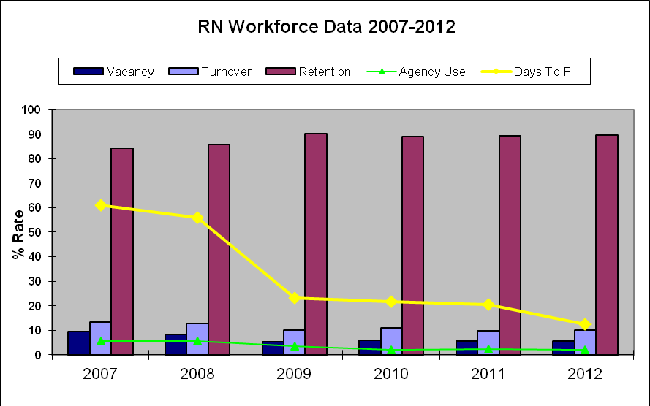
Maryland Hospital Personnel Survey Data Trends

Slide 8
Nurse Support Program II
All 26 Maryland Schools of Nursing have participated in at least one of the NSP II grant cycles for broad regional impact, inclusivity and diversity across the State of Maryland.
NSP II grants have supported new nursing programs at both the undergraduate and graduate level, along with post-graduate teaching certificates and professional development. In the statewide initiatives, new and existing nursing faculty have benefited from graduate scholarships, faculty fellowships and doctoral grants.

Slide 9
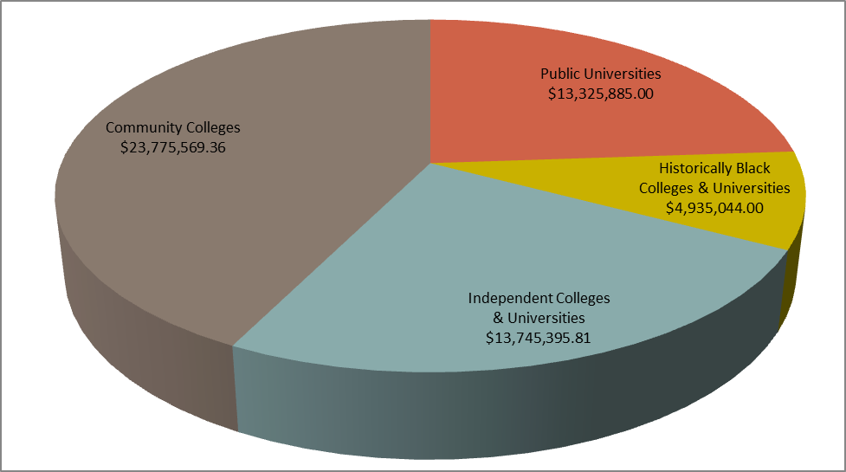
NSP II Institutional grant Funding -FY 06- FY 13

Slide 10
nursing and nurse faculty careers for Minorities
§ 11-405. Nurse Support Program Assistance Fund ( Education Article) Annotated Code of Maryland
(a) "Fund" defined.- In this section, "Fund" means the Nurse Support Program Assistance Fund. (b) Established; status; administration; investments.- 1. There is a Nurse Support Program Fund in the Commission. 2. The fund is a continuing, nonlapsing fund that is not subject to §7-302 of the State Finance and Procurement Article 3. The Treasurer shall separately hold and the Comptroller shall account for the fund 4.The fund shall be invested and reinvested in the same manner as other State funds 5. Any investment earnings of the fund shall be paid into the fund (c) Composition.- The Fund consists of revenue generated through an increase, as approved by the Health Services Cost Review Commission, to the rate structure of all hospitals in accordance with § 19-211 of the Health - General Article. (d) Expenditures.- Expenditures from the Fund shall be made by an appropriation in the annual State budget or by approved budget amendment as provided under § 7-209 of the State Finance and Procurement Article (e) Use of money; guidelines.- The money in the Fund shall be used for competitive grants and statewide grants to increase the number of qualified bedside nurses in Maryland hospitals in accordance with guidelines established by the Commission and the Health Services Cost Review Commission. (f) Guideline provision for minority recruitment.- The guidelines established under subsection (e) of this section shall provide that a portion of the competitive grants and statewide grants be used to attract and retain minorities to nursing and nurse faculty careers in Maryland. [2006, chs. 221, 222.]

Slide 11
Border 4 States & DC= Commuters
According to the Bureau of Labor Statistics’ Employment Projections 2010-2020 released in February 2012, the Registered Nursing workforce is the top occupation in terms of job growth through 2020.
Projection= the # of employed nurses will grow from 2.74 million in 2010 to 3.45 million in 2020, a 26% increase
Projection= need 495,500 replacements in the nursing workforce bringing the total number of job opening for nurses due to growth and replacements to 1.2 million by 2020.
http://www.bls.gov/news.release/ecopro.t06.htm

Slide 12
Maryland Department of Labor, Licensing and Regulation (DLLR)
Health Care Practitioner and Technical Occupations with the Most Projected Openings, 2008 to 2018
Projected Annual Openings Projected (2008-2018)
Registered Nurses 51,290 2,042 22.3%
LPN and LVN 10,975 554 19.1%
Pharmacy Tech 5,865 317 28.8%
Physicians/Surgeons 9,790 256 8.5%
Pharmacists 5,175 199 16.2%
Maryland Health Care Reform Coordinating Council, Health Care Workforce Workgroup, White Paper, October 31, 2010

Slide 13
Snapshot of nursing Graduates
In FY 2013, 3,026 nursing graduates completed programs designed for entry to practice with 2,598 passing NCLEX for licensure.
This is an increase from the 2,615 new nursing graduates in FY 2006 with 2,039 passing NCLEX for licensure.
The MBON FY 2013 report reflects the percentage of new registered nurses (RNs) prepared at Bachelors (42%) to Associates (58%).
In 7 years, we have increased new grad RNs ~400 or about 14%. The Maryland DLLR forecasted 22.3% more needed and US BLS 26% more are needed.

Slide 14
Maryland Reports
Health Care Reform Coordinating Council’s Workforce Workgroup White Paper ( see links)
Preparing Maryland’s Workforce for Health Reform: Health Care 2020 was released in Fall, 2011
Funded by the US-DHHS, HRSA, October 2010
$150K planning grant- primary care- MD,PA, NP
Roadmap to grow workforce 25% in 10 years
Planning, analysis, non-traditional paths, primary care distribution and reimbursement- Note “Action Items”
https://www.youtube.com/watch?v=wfnhfkMKxYw

Slide 15
Maryland Health Reform
Workforce Development Is Everyone’s Business and there are many Stakeholders
$4.98 million in ACA funding to support training of providers to improve preventive medicine, health promotion and disease prevention.
EARN program (Employment Advancement Right Now)
2013 bill which provides grant dollars to match Marylanders seeking new or better jobs with the workforce needs of Maryland employers.
Businesses, government, and educational institutions will collaborate to create training programs that help prepare people for jobs in high-demand fields, including health care.
SIM Model Design planning
Use of community health worker
Identification of best practices and inventory of training models
Workforce Advisory Committee
Educators, practitioners, and other stakeholders to recommend and help support workforce development initiatives, including:
Training opportunities to increase workforce diversity and align with emerging care delivery models;
Workforce data collection, analysis, and reporting.
Licensing and credentialing – identify opportunities to streamline, reduce barriers, and make more efficient.

Slide 16
Nursing Updates
The Institute of Medicine’s report, The Future of Nursing: Leading Change, Advancing Health recommends that a greater emphasis be placed on making the nursing workforce more diverse, particularly in the areas of gender, race and ethnicity; not only as a means of meeting workforce demand but to improve health outcomes, reduce costs and improve the quality of patient care. This report highlights “having enough nurses with the right kinds of skills will contribute to the overall safety and quality of a transformed healthcare system.”

Slide 17
“NSP I” was Renewed in 2012
Steering Committee of Hospital Nurse Leaders led the evaluation process. Findings were reviewed and the program was renewed for 5 years in July, 2012.
According to the HSCRC Wage and Salary Survey, Maryland hospitals increased the number of nurses by 15% and decreased their dependence on agency nurses by 68% between 2007 and 2011. This represents a savings of $98 million in agency costs related to efforts to reduce hospital turnover and increase the number of registered nurses in the workforce.

Slide 18
Nursesupport.org- joint initiative
The IOM evidence- based report, The Future of Nursing: Leading Change, Advancing Health blueprint, as well as steering committees composed of hospital nursing leaders and nursing education leaders have reinforced the direction of both NSP I and NSP II, with new strategies in the development of a joint initiative, the Nurse Support Program website www.nursesupport.org
These goals include: increasing the percentage of BSN’s, doubling the number of doctoral prepared nurses,nurse residency and lifelong learning options.

Slide 19
Initiatives to Implement the IOM’s Future of Nursing report
An action oriented blueprint following recommendations.
IOM Recommendation 4: Increase the proportion of nurses with a baccalaureate degree to 80 percent by 2020
IOM Recommendation 5: Double the number of nurses with a Doctorate by 2020
IOM Recommendation 6: Ensure that nurses engage in lifelong learning
IOM Recommendation 8: Build an infrastructure for the collection and analysis of inter­-professional health care workforce data

Slide 20
Innovative Education Systems
New approaches and educational models are needed to ensure curricula are readily adaptive to increasing technological and evidence-based changes in patient care.
Ex: traditional RN-to-BSN programs; traditional 4-year BSN programs; collaborative educational partnerships to allow for automatic and seamless transitions from an ADN to a BSN; new providers of nursing education; simulation and distance learning through online courses; and academic-service partnerships. MD IOM Committee #4 recommends competency based models for seamless transition

Slide 21
Facilitate Inter-disciplinary Education
This includes removing barriers and promoting successful transitions by veterans and other displaced workers into nursing career paths. Participate with NSP I funded hospital based Nurse Residency programs, to support Associate Degree nurses with incentives to continue on for the BSN degree.
Shared clinical simulation experiences, problem-based learning experiences, shared resources or supplies, activities to increase inter-professional collaboration.

Slide 22
Student Retention and Success
In order to ensure broad coverage of identified needs and avoid duplicative funding with Who Will Care, partnerships with experienced retention programs are recommended. This will help identify effective strategies for working with diverse student populations, and the redesign of the nursing curricula across programs. Projects must provide an objective method of evaluating the causes of nursing student drop-outs or stop-outs, and developing effective interventions to address them.

Slide 23
Faculty Development in Workforce Planning
Develop a Maryland statewide faculty workforce plan- to determine faculty needs, to educate nurses and optimize utilization of limited faculty resources.
Develop a central nursing workforce data center which monitors progress towards the IOM recommendations, supporting research based policy decision making.
Promote nursing education as a desired career path.
Assess and evaluate faculty development activities.
Promote a statewide standard to increase the percentage of doctoral completions, achievement of advanced professional credentials and certifications as nurse educators.
Develop open access web-based faculty resources, openings, registry, etc.
Evaluate successful strategies for nursing programs to identify, recruit, retain and assist qualified nurses to grow into faculty careers- targeting diversity, ie: younger ages, male gender and ethnic, racial or cultural diversity to reach underrepresented groups in nursing faculty and the nursing profession.
Develop innovative solutions to address faculty salary disparities.
Determine impact of wage freezes, along with the increasing contractual and adjunct faculty use. Provide a fiscally sustainable plan for faculty retention.

Slide 24
Guidelines for Proposals
I. | Cover Sheet
II. | Abstract
III. | Table of Contents
IV. | Proposal Narrative
V. | Budget and Cost Effectiveness
VI. | Memorandum of Understanding, if applicable
VII. | Assurances
Applications for all Competitive Institutional Grants must include the seven sections identified below. Detailed instructions are provided for each section. See RFA for more information
One signed original proposal and eight paper copies must be submitted to MHEC offices at 6 N. Liberty Street, 8th floor, Baltimore, MD no later than Friday, May 2, 2014 by 5 p.m.

Slide 25
Review Panel Process
Criteria
Maximum Points
Needs Assessment and Proposed Initiative | 10
Project Goals and Objectives | 15
Scope of Proposed Project (Plan of Operation) | 30
Management Plan | 15
Project Evaluation | 20
Budget and Cost Effectiveness | 10
Total | 100
The recommendations of the review panel will be presented to the HSCRC, who will make the final determination.

Slide 26
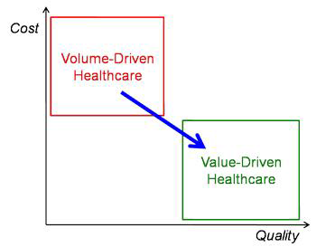
Health Services Cost Review Commission
Modernization of the Waiver
Triple Aim-the Health,
the Care, the Cost
Maryland is the only state in the nation to operate an all-payer hospital rate setting system for 36 years, under which all patients pay the same rate for services at the state’s hospitals.
CMS agreed to give the state five years to generate $330 million in Medicare savings or lose the waiver and convert to the system that other states use.

Slide 27
Modernization of Waiver, January, 2014
"This is among the most important changes in the health care delivery system in the state of Maryland in a generation,"
John Colmers,
Chair of HSCRC
Call for White Papers
The HSCRC is requesting assistance from interested parties in the form of technical papers on several different topics. The purpose of the papers is to provide data analyses, policy analyses and background information to inform implementation decisions. The call for papers is for interested stakeholders, members of the research community and the general public who want to voluntarily contribute to the implementation planning. http://www.hscrc.state.md.us/hscrc-modernization-white-papers.cfm

Slide 28
Nursing Workforce Research
NSP II Initiative #5 includes opportunities for White Papers- We need reports on publications of successful strategies and scholarly contributions from our NSP II stakeholders. We need data, research, and analysis of the nursing workforce in Maryland.
The last Maryland Nursing Workforce report was in 2003, released by Heller & Sweeney, Center for Health Workforce Development, which was later disbanded in 2005, along with the Statewide Commission on the Crisis in Nursing.
Based on Demand Model outcomes:
Projections Optimistic Pessimistic
2003 shortage 1,990 3,622
2008 shortage 2,150 11,397
2012 shortage 11,097 20,091
This is the 9th year of a workforce intervention funded for 10 years.
Nursing researchers, leaders and stakeholders are urged to help. http://www.mbon.org/commission/mid_evaluation.pdf

Slide 29
ROI- Return on Investment
ROI is the net result of
–Nursing Workforce Supply and Demand = Costs
–NSP II effectiveness in increasing quality, improving patient outcomes and reducing costs of care
Funding –based on operational implementation and ROI analyses for each grant and targeted workforce interventions
Analysis of successful strategies for replication
Consider factors adversely impacting program effectiveness and remaining unmet needs
Evidence of NSP II effectiveness is extremely important as is cautious, thoughtful estimation of same, where gaps in evidence exist
Rely on grant reports, changes in nursing workforce, faculty workforce and expanded educational capacity

Slide 30
Advancing Educational Attainment
In addition to increased numbers of Associate Degree registered nurses, BSN-educated nurses, and RN-BSN, schools of nursing must build their capacities to prepare more students at the graduate level who can assume roles in advanced practice, leadership, teaching, and research.
58% New RN’s are Associate Degree Nurses
42% New RN’s are Bachelor Degree Nurses
13% of nurses hold a graduate degree but only
1% of nurses hold a doctoral degree.
Nurses with doctorates are needed to teach future generations of nurses and to conduct research that becomes the basis for improvements in nursing science and practice.

Slide 31
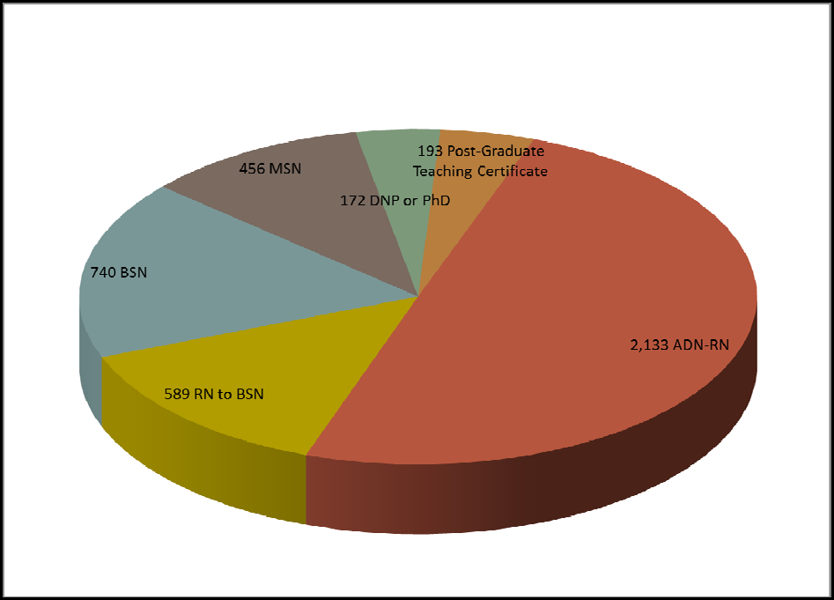
Competitive Grants outcomes 2007-2012

Slide 32
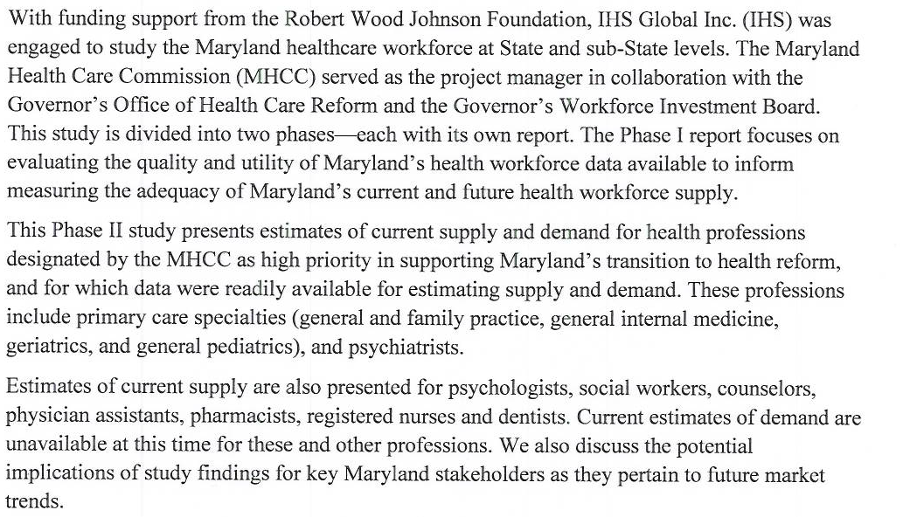
Interest in Health Workforce

Slide 33
Maryland Health Workforce Study (2013-2014)
The overarching goals of Phase I and Phase II of this health care workforce study is to conceptualize a data collection and forecasting system designed to provide an updated picture of the current and projected future adequacy of the State-wide and sub-state supply of health professionals in Maryland.
This was a RWJF funded project directed by MHCC on behalf of GWIB and the Office of Health Care Reform
Summation: Data is not readily available to estimate demand or adequacy of supply for many health professions and primary care must consider APRN’s
Key take away for nurse leaders: we have a responsibility to address data infrastructure- it is still a major concern.

Slide 34
Dr. Buerhaus
Employers and workforce policymakers should not be lulled into complacency by the current supply of nurses.
The current positive effect is likely to evaporate as the economy improves with a reemergence of a post-recession nursing shortage.
In the face of projected shortages of primary care MDs, slower growth in the RN workforce could not come at a worse time.
The demand for RNs will outstrip projected growth through 2020. (Buerhaus, 2012, NEJM)

Slide 35
FY 2014 Grant Recipients
NSP II FY 2014 Final Recommendations for Competitive Institutional Grants Program
Proposal Name School of Nursing Funding
14‐101 A Faculty Pipeline for RN to BSN and BSN to MSN Bowie State University $212,723
14‐102 CCBC Associates to Bachelors (ATB) CCBC $298,957
14‐103 Initiative to Promote Nursing Education as a Career Path Coppin State University $290,320
14‐104 Planning the Pathway to an MSN in Western Maryland Frostburg State University $145,842
14‐105 3 + 1 Model: A new route to the BSN Hagerstown Community $174,664
14‐106 Interdisciplinary Simulation to Enhance Students Howard Community College $268,290
14‐107 Accelerated Post‐NP Psychiatric Nurse Practitioner Johns Hopkins University $299,709
14‐108 Online Use of Inter-professional Simulation Johns Hopkins University $284,687
14‐109 Establishing a Faculty Consortium Nursing Leadership Johns Hopkins University $297,554
14‐110 Military to ADN(M2ADN) Montgomery College $226,522
14‐111 Increasing Success in Minority Nursing Students Sojourner‐Douglass College $237,351
14‐112 Increasing Academic‐Practice Partnerships in Maryland Stevenson University $276,942
14‐113 Clinical Faculty for Maryland Schools University of Maryland $295,573
14‐114 Increasing the Baccalaureate Nurses University of Maryland $298,915
14‐115 Inter-professional Education, faculty development University of Maryland $299,928
Total 15 applicants $3,907,977 awarded for 1-2 year programs in FY 2014

Slide 36
Complex Primary Care Needs
**Psychiatric Nurse Practitioners are needed in Maryland
Start as RNs (all 26 SON part of the solution)
Continue in Graduate School
Complete specialty nurse practitioner program
Two Psych NP programs in Maryland (PMHNP)
Each graduate about 16/ yr.
Becoming more difficult with 2015 AACN goals- DNP
How can we meet this need?
Nurse educators- any ideas?
DHMH is interested- contact Raquel Samson raquel.samson@maryland.gov

Slide 37
Acknowledgement of Funding
An acknowledgment of the HSCRC must appear in any publication of materials based on or developed under this project in the following manner:
“The activity that is the subject of this [type of publication (e.g., book, report, film)] was produced with the assistance of a Nurse Support Program II grant under the auspices of the Health Services Cost Review Commission.”
At such time as any article resulting from work under this grant is published in a professional journal or publication, two reprints of the publication should be sent to MHEC and HSCRC, clearly labeled with appropriate identifying information.

Slide 38
References
American Association of Colleges of Nursing’s Special Survey on Vacant Faculty Positions for Academic Year 2012- 2013 http://www.aacn.nche.edu/leading-initiatives/research-data/vacancy12.pdf
http://www.aacn.nche.edu/media-relations/nrsgshortagefs.pdf
Institute of Medicine, (2010) report, The Future of Nursing: Leading Change, Advancing Health. Retrieved from http://www.iom.edu/Reports/2010/The-Future-of-Nursing-Leading-Change-Advancing-Health.aspx
Health Services Cost Review Commission, Nurse Support Program II,
www.hscrc.gov
http://www.hscrc.state.md.us/documents/commission-meeting/2013/06-05/hscrc-post-commission-meet-docs-2013-06-05.pdf

Slide 39
References
Federal Government Approves New Medicare Waiver for Maryland retrieved from http://articles.baltimoresun.com/2014-01-10/health/bs-hs-medicare-waiver-approved-20140109_1_john-colmers-waiver-hospital-reimbursement-rates and
Office of Governor Martin O’Malley
Http://www.governor.maryland.gov/blog/?p=9717
Health Reform http://www.healthreform.maryland.gov/wp-content/uploads/2013/10/HCRCC-SIM-.pdf

Slide 40
References
Health Personnel Shortage Incentive Grant (HPSIG)
http://mhec.maryland.gov/grants/healthshortagegrant/fy09/hpsigguidelines.pdf
Maryland Health Care Reform Coordinating Council, Health Care Workforce Workgroup, White Paper, October 31, 2010
http://www.healthreform.maryland.gov/wp-content/uploads/2012/03/WorkforceWorkgroup.pdf
Maryland Board of Nursing, http://www.mbon.org/commission/mid_evaluation.pdf

Slide 41
References
Maryland Higher Education Commission, Nurse Support Program II,
www.mhec.state.md.us
Michie’s Annotated Code of Maryland, Education, 2006, 11-405, pg. 502, Matthew
Bender & Company, Inc., Charlottesville, VA.
Maryland IOM Action Committee #4, verbal communication from Barb Nubile, co-chair
to P. Daw, MHEC from the meeting in Elkton, Maryland on 1/11/13 to promote transitions from ADN to BSN.

Slide 42
References
Maryland Health Workforce Study Phase One Report: Assessment of Data and their Utility for Modeling Clinician Supply and Demand, IHS INC, Washington, DC, available from GWIB
Maryland Health Workforce Study Phase Two Report: Assessment of Health Workforce Distribution and Adequacy of Supply, IHS INC, Washington, DC
Staiger, D., Auerbach, D. & Buerhaus, P. (2012). Registered Nurse Labor Supply and the Recession- are we in a bubble? New England Journal of Medicine, 366(16), 1463-1465.

