Slide 1
Nurse Support Program II Competitive Institutional Grants
Maryland Higher Education Commission
&
Health Services Cost Review Commission
February 11, 2013
Peg Daw, NSP II, Office of Grants & Outreach, MHEC
Oscar Ibarra, Chief, Information Management
and Program Administration, HSCRC

Slide 2
Nursing is the largest health profession

Slide 3
Nurse Support = Nursing Excellence
A number of studies have shown a link between higher nursing education and better patient outcomes. One study showed compelling evidence that a 10 percent increase in the number of BSN degree nurses decreased the risk of patient death and failure to rescue by 5 percent. ( June, 2012, HSCRC)
L. H. Aiken, S.P. Clarke, R.B. Cheung, D. M. Sloane, & J.H. Silber. Educational Levels of Hospital Nurses and Surgical Patient Mortality. Journal of the American Medical Association. 290:12 (2003). 1617-1623
NSP I and NSP II are focused on supporting nursing excellence.
In agreement with both ANCC Magnet Centers of Excellence and
the IOM’s Future of Nursing: Leading Change, Advancing Health
this RFA seeks applicants--- aligned with nursing excellence.

Slide 4
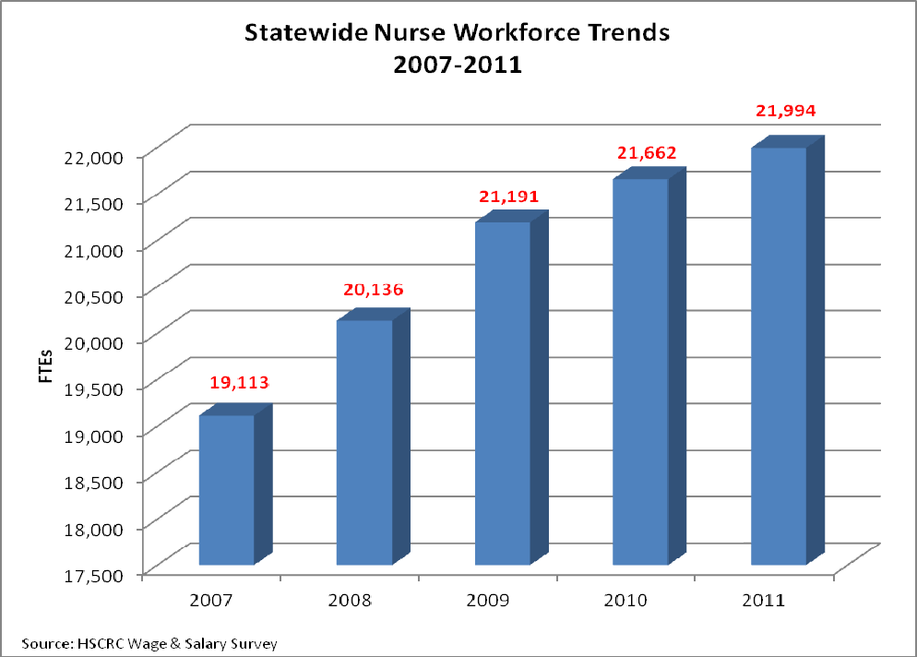

Slide 5
NSP I- Hospital Based Goals
In an effort to raise the bar for Maryland nurses, the NSP I programs are encouraged to focus on three areas:
Education and career advancement. This area includes initiatives that increase the number of advance degree nurses; nursing residency programs; leadership initiatives and succession planning.
Patient quality and satisfaction. This are includes data collection efforts that can demonstrate the link between improved nursing competency and better patient outcomes.
Advancing the practice of nursing. This area includes activities that advance the practice of nursing, such as staff driven evidenced-based research in nursing, attendance at symposiums and research conferences, as well as achieving or maintaining Magnet status.

Slide 6
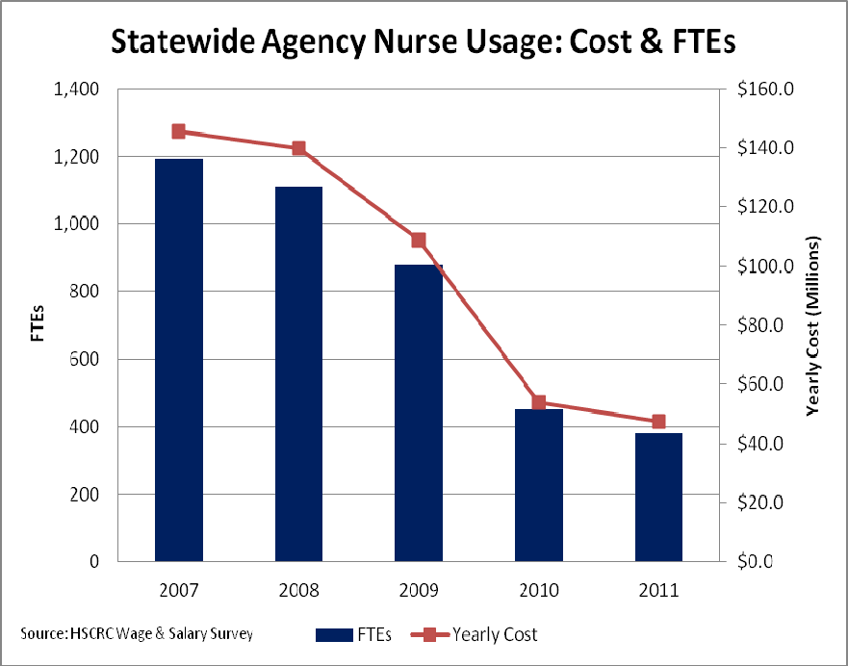
Hospitals saved $98 Million

Slide 7
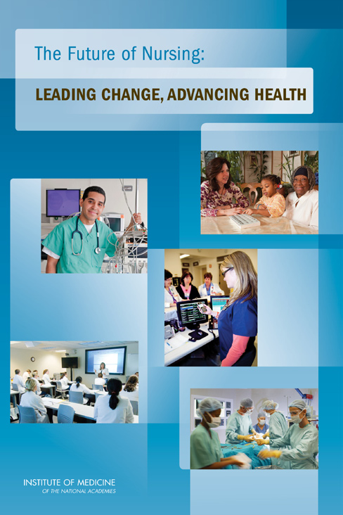
Nurse Support Program I & II
Six of the 8 recommendations were incorporated into the scope of the NSP I & II:
IOM Recommendation 3:
Implement Nurse residency programs
IOM Recommendation 4:
Increase the proportion BSN
degrees to 80 percent by 2020
IOM Recommendation 5:
Double the number of nurses with Doctorates
IOM Recommendation 6:
Ensure lifelong learning
IOM Recommendation 7: Prepare &
enable nurses to lead change
IOM Recommendation 8: Build an infrastructure for the
collection and analysis of inter-professional health care
workforce data.

Slide 8
RN Trends 2007- 2011
Maryland Nursing Programs increased the graduates by 19% between 2007 and 2011
2007 2011
Nursing Graduates 2615 3429
MBON NCLEX-RN pass 2039 2519
MHA vacancy rates 10.2% 5.6%
Maryland hospitals increased the number of nurses by 15% between 2007 and 2011
New RN Employment at 6 months = 88% average with some geographical and program variability from 1/17/13 Survey

Slide 9
NSP II- Funding
All 26 SON Awarded FY 06-13
Current Availability
Between FY 2006 and FY 2013, the HSCRC has approved over $55.7 million in funding for 79 Competitive Institutional Grant awards involving all 26 schools of nursing with 78 hospital and higher education institution partners and consortium members and $14.5 million for Statewide Initiatives.

Slide 10
Nursing Investments
NSP I and II funds are added to each hospital’s rates. Hospitals receive up to 0.1% of the hospital’s gross regulated patient revenue for the prior year.
All 42 acute care hospitals were funded between FY 2001 through FY 2013, ~ $80.6 million to support NSP I programs and all 26 nursing programs funded between FY 2006 and FY 2013,~ $70million for NSP II. Total investment of~ $150 million over 12 years for both NSP initiatives.
If $98 Million was saved in 5 yrs, the investment in nursing programs at hospitals and schools indicates:
NSP I and II are clearly cost effective and beneficial.

Slide 11
Nursing Resources
NSP II
NSP I
www.nursesupport.org a new tool for the Nurse Support Program

Slide 12
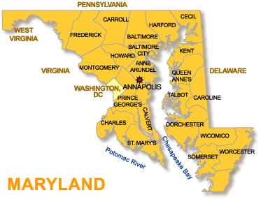
Interlocking Goals
Nurse Support Program I
Nurse Support Program II
1.Increase nursing faculty capacity and diversity
2.Expand the education pipeline and address barriers to nursing education pathways
3.Promote innovation in nursing education models
Consider NSP I and NSP II with:
Nursing Goals Health Care Goals
Workforce Goals
State Goals
National Goals
1.Increase the number of
bedside nurses in Maryland
through retention and
recruitment
2.Align the NSP I program with
the IOM’s Future of Nursing
report with emphasis on
increasing the number of nurses
with higher levels of education,
improving the clinical
competencies of nurses, and
elevating the practice of nursing
through evidenced-based research

Slide 13
2012-2013 Action Committee Maryland Strategic Plan
IOM Recommendations
The right place, the right time
for Nursing Excellence
#1 Scope of Practice Barriers
#2 Lead Interdisciplinary teams
#3 Nurse Residency
#4 Increase BSN % by 2020
#5 Double Doctorates by 2020
#6 Lifelong Learning
#7 Lead Change- Advocate Health
#8 Data Infrastructure
An evidence-based blueprint for the nursing profession.

Slide 14
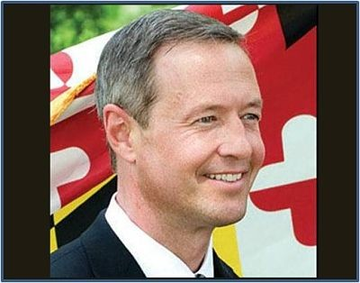
Complete College America Completion Innovation Challenge
Maryland State Goal
Maryland awarded $1,000,000
“It is more important than ever to ensure that Marylanders earn their degrees,” said Governor O’Malley. “This grant award will go a long way toward helping our State’s higher education institutions implement strategies to eliminate barriers to completion and help students get the degrees they need to compete and win in the new economy.”
http://www.mhec.state.md.us/RSSFeeds/Grants.xml
Governor O’Malley has set a statewide attainment goal that, by 2025, at least 55 percent of the State’s residents aged 25-64 will hold at least one degree.

Slide 15
STUDENT Success Critical
Governor’s Statewide Focus
Replicable Models- Funding
“Maryland College Access Challenge Grant” and “One Step Away” programs at MHEC
The mandatory project goals are (1) increase the persistence rate of participants compared to a control group and/or historical trends and (2) participants will either attain or remain in good academic standing. Outcomes data is critical. Grant awards range from $25,000 to a maximum of $100,000 per institution.
FY 2014 Who Will Care’s #1 Priority: Retention Strategies
Deadline was 2/8/13
Community College of Baltimore County received NSP II funding with national recognition in 2011 with the Noel Levitz Award for their Student Success Programs. Chesapeake College, Cecil College, Baltimore City Community College and Wor-Wic Community College have received funding to support student success initiatives. NSP II supports proven models.
FY 2014 NSP II funds available, if not funded by other sources.

Slide 16
NURSING FACULTY INITIATIVES
Eastern Shore Faculty Academy & Mentorship Initiative
At Salisbury University, with Chesapeake College and Sojourner-Douglass College
Institute for
Educators in
Nursing and Health Professions
at University of Maryland

Slide 17
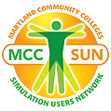
SIMULATION Facilitation
Maryland Faculty Academy for Simulation Teaching (M-FAST) housed at Johns Hopkins, offered to 10 initial schools of nursing in a statewide consortium model led by internationally recognized expert Dr. Pam Jeffries.
15 Scenarios were developed & 62 Faculty participated from:
Montgomery
Carroll Harford
Bowie Howard
Stevenson
Coppin Johns Hopkins Towson
Wor-Wic
Maryland Community Colleges Simulation Users Network at Hagerstown Community College includes university and hospital partners in their membership. Join MCC-SUN now! Upcoming Simulation Conference
June 4 & 5, 2013 http://www.mccsun.org/

Slide 18
NEW BACCALAUREATE PROGRAMS
Morgan State University, Notre Dame of Maryland and Sojourner-Douglass College started new undergraduate degree programs through projects supported by NSP II funding.
Students are recognized under-represented minorities in nursing.

Slide 19
ACCELERATED DEGREES
Accessible & Accessible
Associate Degrees
Harford, Howard & Prince Georges Community Colleges were funded to develop night, weekend and hybrid programs that met the needs of working adults to complete programs in as little as 15 months. Many of these were under-represented populations in nursing like men who were returning military veterans transitioning into civilian roles with prior training as medics, corpsmen or local community based EMT’s and paramedics to RN’s.

Slide 20
DOCTORAL EDUCATION PROGRAMS
Eastern Shore DNP Started
UMB- DNP Expanded
AACN 2006-2011National Growth of Doctoral Nursing Programs
Doctor Nursing Practice DNP
Research Focused PhD
In FY 2013, Salisbury University received funding to begin the first doctoral education program in nursing on the Eastern Shore, a DNP program that will quickly transition to distance format for ease of accessibility to meet regional nursing education needs. University of Maryland expanded their DNP with additional funding.
182
20
126
103
PhD 18% increase / DNP 89% increase

Slide 21
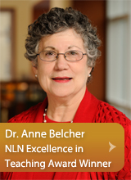
Post-Docs & Certificate Education
On-line Preceptor Modules
Post-Docs for DNPs
GuIDE Initiative with Boot Camp
For clinical and academic faculty
Nurse Educator Certificate Option (NECO) online
Nurse Educator certificate option at the Johns Hopkins University School of Nursing enables experienced professional nurses to combine their clinical expertise with a passion for teaching.

Slide 22
Improved Educational Systems
Existing
Changing
RN-BSN programs
Traditional BSN programs
Distance Learning
Academic –Service Partnerships
8 Regional Higher Education Centers like:
Geographically located to cover the state
Increased interdisciplinary health professional programming
New providers of nursing education
New requirements for out of state online educational programs
Recently a bill was passed by the Maryland legislature and signed into law by Governor O’Malley which requires the registration of all out-of-state fully online programs that enroll Maryland students at MHEC

Slide 23
Model for Dual Enrollment
18 Month Developmental Project –
a partnership for a state model
Montgomery College
& UMB at Shady Grove
The Nurse of the Future Competency Model
Competency- Defined as “the habitual and judicious use of communication, knowledge, technical skills, clinical reasoning, emotions, values and reflection in daily practice.

Slide 24
Assumptions for the Model
FIVE SHARED BELIEFS
1. Education and Practice partnerships are key to developing an effective model.
2.Nursing education and practice setting should facilitate individuals to move more effectively through the educational system.
3. An integrated practice/education competency model will positively
impact patient safety and improve patient care.
4. Nursing practice should be differentiated according to the registered
nurse’s educational preparation and the level of practice and further
defined by the role of the nurse and the work setting
5. Practice environments that support and enhance professional competence are essential.
On Jan 11, 2013 in Elkton, MD, Maureen Sroczynski, DNP, RN, Regional Nursing Expert/Consultant, AARP Center to Champion Nursing in America, cited four major national models for increasing the number of BSN prepared nurses. She highlighted the Massachusetts competency model as a means of facilitating partnerships with various universities and community colleges.

Slide 25
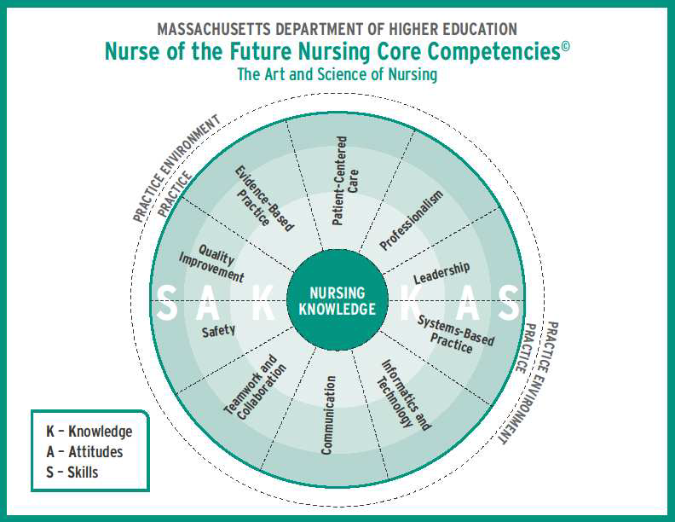

Slide 26
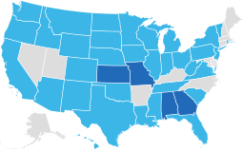
Data Infrastructure Needed
Health Care 2020 Report released January 2011
The Forum of State Nursing Workforce Centers
Maryland is one of the last States without a center
12/12/12 Healthcare
Workforce Data Initiative by GWIB & industry partners Important to Policy & Decision making
At present, Maryland has no centralized capacity for collecting, analyzing, and reporting health care workforce data. This capability is critical to identifying key workforce issues, assessing the magnitude of those issues, and providing evidenced-based information for the formulation of improved public policies.

Slide 27
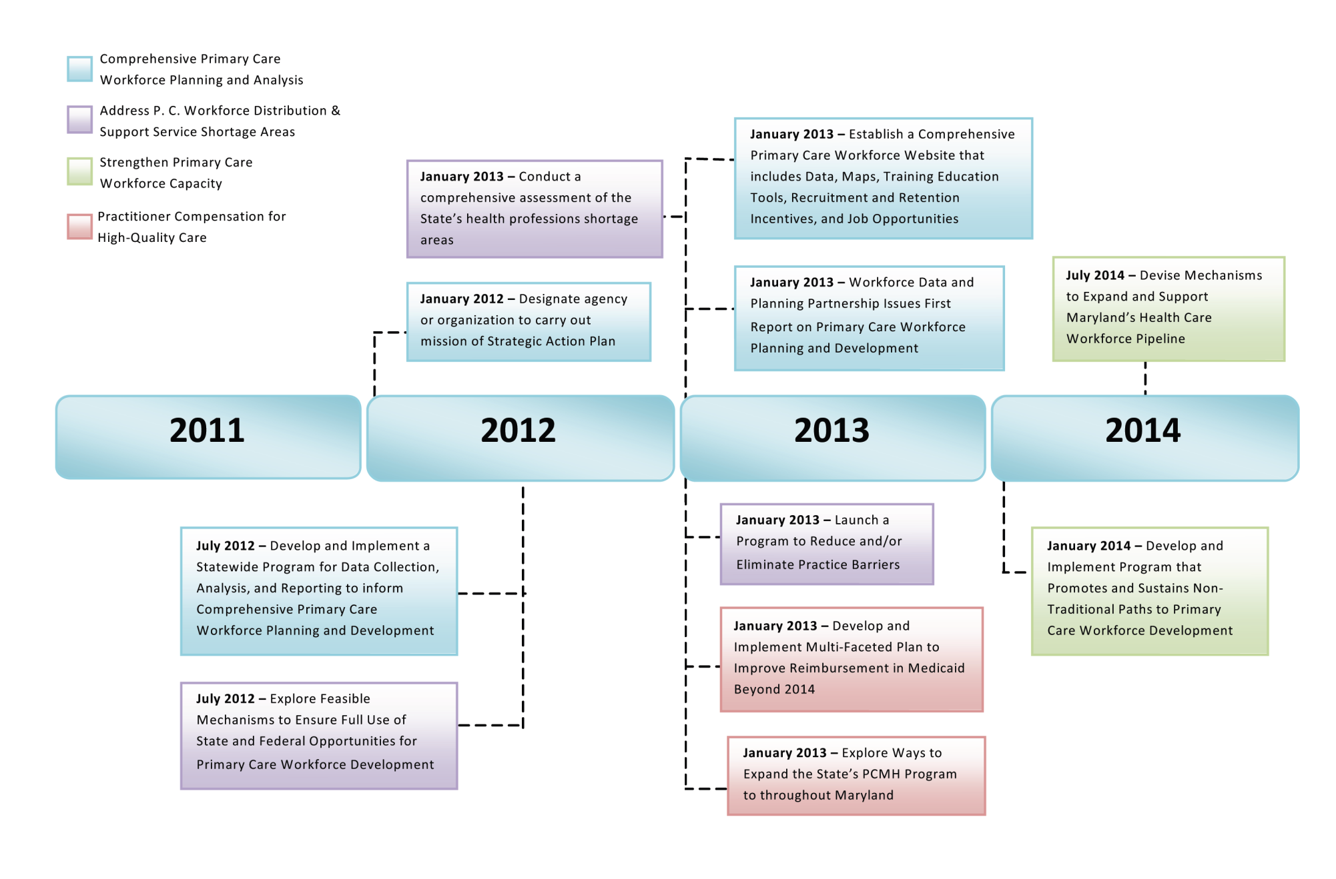
Health Care 2020 Development Timeline

Slide 28
Taking the Long View- Policy- Planning
Purpose
Data Sets
Adoption of the datasets will enhance our ability to plan for imbalances in nurse supply and demand, position us to course-correct in response to changing conditions, and, ultimately, improve healthcare for all Americans.
www.nursingworkforcecenters.org
These documents are intended to establish standardized data to be collected by each state as part of a larger effort to effectively quantify and address the country’s critical nursing shortage - which is expected to grow to between 340,000 and 1,000,000 Registered Nurse full-time equivalent vacancies by 2020.
Minimum Nurse Supply Dataset
Minimum Nurse Demand Dataset
Minimum Nursing Education Program Dataset

Slide 29
May 26, 2011 Meeting Committee# 4& #5
Review changes in Doctoral pursuit funding, opening door to facilities to increase capacity in Maryland SON
Get more Associate Degree Nurses to move towards Bachelor’s Degree through marketing and career outreach
Increase Ph.D.’s capacity. Accept out of state programs for Maryland faculty seeking seats ( DE , hybrid, traditional)
Capitalize on experienced Maryland educators, so they can teach in PhD programs. Reach out to new Nursing Doctoral Programs with expertise and support of existing programs.
Community College and Universities have workgroups to make transition easier (through philosophies/structure). Create projects to bring community colleges and universities in alignment through language and courses.
Focus on nursing faculty career path- accessing-attracting-advancing- retaining-respecting-rewarding with the final destination of a doctoral education
Build consensus within nursing educators- both experienced and retired nursing faculty- to be the public voice for the nursing excellence position.
Research current cost-benefit ratios- personal and financial investments in the final career satisfaction and longevity as nurse faculty
MESSAGE- WE ARE MOVING FORWARD ON LONG RANGE GOALS

Slide 30
Certified Nurse Educator (CNE)
The Value of Certification
Stevenson University Department of Nursing Stevenson, MD May 21, 2013
Workshop by NLN
Distinguish academic nursing education as a specialty area of practice and an advanced practice role within professional nursing
Cecil College’s CNEs:
Christy Dryer, DNP, RN, CNE
Marta Hayden, MSN, OCN, RN, CNE
Cindi Horton, EdD, MSN, RN, CNE
Roxanne Rash, EdD, ND, MS, RN, CNE
Certification in any field is a mark of professionalism. It communicates to students, peers, and the academic and health care communities that the highest standards of excellence are being met.
www.nln.org

Slide 31
Each of You Play a Vital Role
Nursing Educators play a vital role in the development of the nursing profession.
Lay the foundation for how nurses practice and interact with patients, families, communities, fellow nurses and other health care professionals. Model ethical decision making, critical thinking, caring and professional behavior.
President Obama recognized nurses as the “bedrock” of health care. “Quite simply, nurses are on the front line of America’s healthcare system. Every day, with your hard work, with your skill, your compassion, nurses determine the quality of care that we all receive.” First Lady Michelle Obama

Slide 32
New Horizons
www.Nursesupport.org
Post upcoming events
Maryland nursing research reports
Recognize fellowships and grantees
Share best practices
Provide password protected access to simulation scenarios created through NSP by nursing faculty for statewide resources
Electronic submissions of reports

Slide 33
Dates to Note :Phase 8 FY 2014
Friday, March 15, 2013 Proposals due by 5:00 p.m. at MHEC
Wednesday, May 1, 2013 HSCRC Meeting, Final Draft Recommendations
Wednesday, June 5, 2013 HSCRC Meeting, Final Approved Projects
Week of June 12, 2013 Notification of grant awards made
July 1, 2013 Projects begin
July 31, 2013 Annual Reports Due for FY 09 - FY13 grants
September 15, 2013 Grant funds processed after Annual reports approved
September 30, 2013 Final Reports Due for all grants ending FY 13

Slide 34
Changes to note: Phase 8 FY 2014 RFA
NSP II was initiated in 2005, with the first round of grants in FY 2006. With FY 2015,new collections term or renew.
Time Frames:1-2 yrs
Funding Amounts Recommend Requests: <$300K
Initiatives: Updated
06-07 | 08 | 09 | 10 | 11 | 12 | 13 | 14 | 15 | 16

Slide 35
Questions?

Slide 36
References
American Association of Colleges of Nursing (2012) Data on Doctoral Programs http://www.aacn.nche.edu/membership/members-only/presentations/2012/12doctoral/Potempa-Doc-Programs.pdf
Benner, P., Sutphen, M., Leonard, V. & Day, L. (2009) Educating Nurses: A call for Radical Transformation, The Carnegie Foundation for the Advancement of Teaching Series, Jossey-Bass, San Francisco, CA.
Governor’s Workforce Investment Board Report (2011) Preparing Maryland’s Workforce for Health Reform: Health Care 2020
http://www.gwib.maryland.gov/pub/healthreformcare2020.pdf
Health Services Cost Review Commission ( HSCRC)
http://www.hscrc.state.md.us HSCRC June 6, 2012 http://www.hscrc.state.md.us/documents/CommissionMeeting/2012/06-06/HSCRC_Post-MeetDocs_2012-06-06.pdf

Slide 37
References
Institute of Medicine, (2010) report, The Future of Nursing: Leading Change, Advancing Health. http://www.iom.edu/Reports/2010/The-Future-of-Nursing-Leading-Change-Advancing-Health.aspx
Maryland Board of Nursing RN- NCLEX Rates
http://www.mbon.org
Maryland Higher Education Commission
http://mhec.maryland.gov/grants/nspii/nspii.asp
Maryland Hospital Association, Hospital Personnel Survey Report for Calendar Year 2011, Dr. Joan Warren, Medstar Research Director

Slide 38
References
Dr. Anne Belcher, Excellence in Teaching Award
http://magazine.nursing.jhu.edu/2011/11/belcher-honored-as-excellent-teacher/ , NSP II-105 Nurse Educator Online Certificate (NECO)Project Director
Dr. Pamela Jeffries and Dr. Linda Rose, NSP II 10-118 Maryland Faculty (M-FAST)Project Directors
Dr. Rebecca Wiseman and Ms. Barb Nubile, NSP II 13-108 Model for Dual Enrollment Project Directors
Dr. Denise Seigart and Dr. Judith Feustle, NSP II 12-115 CNE workshop and Project Directors http://www.nln.org/facultyprograms/Workshops/CNETurchin/index.htm

Slide 39
References
National League for Nursing
http://www.nln.org Workshop at Stevenson University May 21,2013
http://www.nln.org/facultyprograms/Workshops/CNETurchin/index.htm
NSP II Survey 1.17.13 Deans and Directors on Employment rate of RN Grads at 6 months and confirmation with AACN release:
http://www.aacn.nche.edu/news/articles/2013/cnn-article#.UQwYRg0-O-A.email
Maureen Sroczynski, DNP, RN, Regional Nursing Expert/Consultant, AARP Center to Champion Nursing in America presentation on RN Competency Models at Jan 11, 2013 in Elkton, MD- information from B. Nubile,facillitator
Who Will Care? Fund for Nurse Education, Catherine Crowley, EdD, RN
Project Director, ccrowley@mhaonline.org

