Slide 1
Nurse Support Program II
FY 2022 Technical Assistance
Peg Daw & Kim Ford- MHEC
Oscar Ibarra- HSCRC
September 17, 2020

Slide 2
HSCRC and MHEC Contacts
NSP I: Oscar Ibarra, Claudine Williams & Benjamina Quintanilla
oscar.ibarra@maryland.gov
claudine.williams@maryland.gov
benjamin.quintanilla@maryland.gov
NSP II: Peg Daw & Kim Ford
peggy.daw@maryland.gov
kimberly.ford@maryland.gov
Nurse Support Program I and II
www.nursesupport.org

Slide 3
NSP I and NSP II: Two Sides of the Coin
 | Nurse Support Program I | Nurse Support Program II
What is the program? | Non-competitive grant to hospitals to fund projects that address the individual needs of the hospitals as they relate to nurse recruitment and retention. Not intended to fund existing programs that are more appropriately funded through employee fringe benefit programs or to duplicate what is available in rates for traditional hospital-based services or operations. | Comprised of two components: Competitive Institutional Grants and Statewide Initiatives. Competitive institutional grants fund providers of nursing education Statewide initiatives fund individual students and nurse faculty.
What are the goals of the program? | Increase the number of nurses in Maryland through retention and recruitment Increase the number of nurses with higher levels of education Improve the clinical competencies of nurses Elevate the practice of nursing through evidenced-based research | Increase nursing faculty capacity and diversity Expand the education pipeline and address barriers to nursing education pathways Promote innovation in nursing education models
How is the program implemented? | Hospitals are given leeway as to how the programs are implemented, as long as the programs are aligned with the goals of the NSP I program. Some examples of funded programs/initiatives include: Internships/externships for nursing students Scholarships for nurses to pursue advanced degrees Development of nursing leadership and nurse councils Magnet© Journey or Pathway to Excellence© Evidenced-based Practice research | For the Competitive Institutional Grants, Maryland higher education nursing institutions are given leeway as to how the programs are implemented, as long as the programs are aligned with the goals of NSP II. Applicants are encouraged to collaborate, develop partnerships and address current issues in nursing workforce and nursing education. Some examples of funded program/initiatives include: Creating dual roles for nurse clinicians in teaching and clinical care Pathways that fast-track qualified students entering nursing education through community colleges to successfully complete their BSN or MSN

Slide 4
Nurse Support Program II : An Overview
Established in 2005 to increase Maryland’s academic capacity for nursing education
Administered by the Maryland Higher Education Commission (MHEC)
Funded through pooled assessments totaling up to 0.1 % of hospital regulated gross patient revenue
Goal: to increase nursing graduates and mitigate barriers to nursing education through institutional and faculty focused initiatives.

Slide 5
NSP II Program Evaluation
Review the NSP II Program Evaluation December 11, 2019
https://hscrc.maryland.gov/Documents/December%202019%20Public%20Pre-Meeting%20Materialsv2.pdf
NSP II Projects outcomes- review of initiatives, funding, results
Trends ( pre-licensure graduates continued to trend downward)
National nursing workforce projections- nursing shortages
Maryland’s nursing workforce- difficulty accessing MBON data
Hospital concerns- agency nurse use, vacancy rates, turnover
School concerns- clinical site restrictions, lack of clinical sites
Student concerns- tuition, student debt
NSP II impact on 1. increasing nurse graduates, 2.recruiting/retaining/developing faculty,3. increasing educational capacity, 4. increasing diversity and underrepresented groups in nursing, and 5. meeting the IOM and NSP II goals

Slide 6
Major Achievements By Initiative
Initiative #1: Ensuring educational capacity for nursing pre-licensure enrollments and graduates
Increased the first time pass rate for NCLEX-RN nursing licensure by 8.51%
Recruited 162 new nurse faculty into full-time positions, maintaining 93% retention rate.
Initiative #2: Advancing academic preparation of entry-level nurses and existing nurses to meet the needs of hospitals and health systems (80 percent BSN)
Improved time to completion of Associate to Bachelors in Nursing (ATB) by 50%; estimated cost saving of $13K per new nurse graduate
Increased proportion of BSN nurses to 60% to meet hospital skill mix.

Slide 7
Major Achievements By Initiative
Initiative #3: Doubling the number of nurses and nurse faculty with doctoral degrees
Increased the number of doctoral degree completions by 78%
Provided funding for 63 full-time nurse faculty to complete terminal doctoral degree while maintaining a 89% retention rate
Initiative #4: Promoting academic/practice partnerships
Expanded NSP II opportunities to 558 hospital-based nurses across 7 programs.
Provided focused leadership development for 48 nurse faculty and 89 hospital emerging and existing nurse leaders through the Nurse Leadership Institute
Expanded training for 343 nurse faculty and 51 hospital educators; increasing by 12% the use of clinical simulation in lieu of clinical sites.

Slide 8
Major Achievements By Initiative
Initiative #5: Developing statewide resources and models for inter-professional education, alternative clinical practice sites, and clinical faculty preparation
Established the Maryland Nursing Workforce Center and joined 34 other states in the National Forum of State Nursing Workforce Centers
Updated the Maryland Nursing Articulation Education Agreement (originally established in 1985) for seamless academic progression from Associate Degree Nursing to BSN for Licensed Practical Nurses in 2017.

Slide 9
Funding for
Competitive Institutional Grants
FY Awarded | Pre-Licensure Nurses | Academic Progression & 80% BSN | Double Faculty w/ Doctorates | Academic Practice Partnerships | Statewide Resources | Total Funding
FY 2016 | $4,646,705 | $8,499,668 | $0 | $8,621,289 | $1,680,097 | $23,447,759
FY 2017 | $2,136,305 | $7,620,323 | $1,619,142 | $5,758,707 | $431,001 | $17,565,478
FY 2018 | $946,000 | $8,822,041 | $2,796,513 | $2,370,527 | $2,557,878 | $17,492,959
FY 2019 | $4,112,164 | $2,035,313 | $902,000 | $2,194,604 | $345,327 | $9,589,408
FY 2020 | $200,000 | $1,852,583 | $0 | $564,675 | $3,536,189 | $6,153,447
Total Funding | $12,041,174 | $28,829,928 | $5,317,655 | $19,509,802 | $8,550,492 | $74,249,051

Slide 10
Funding for
Statewide Initiatives Faculty-Focused Awards
FY Awarded | Hal and Jo Cohen Graduate Nurse Faculty Scholarship (GNF) | New Nurse Faculty Fellowship (NNFF) | Nurse Educator Doctoral Grants for Practice and Dissertation Research (NEDG) | Academic Nurse Educator Certification (ANEC) | Total Funding
FY 2016 | $1,807,929 | $520,000 | $350,000 | $0 | $2,677,929
FY 2017 | $3,008,537 | $775,000 | $440,000 | $0 | $4,223,537
FY 2018 | $3,220,131 | $805,000 | $305,000 | $0 | $4,330,131
FY 2019 | $3,160,719 | $885,000 | $470,000 | $285,000 | $4,800,719
Total Funding | $11,197,316 | $2,985,000 | $1,565,000 | $285,000 | $16,032,316
Total # of Faculty Funded | 250 | 162 | 63 | 57 | 532

Slide 11
Approved Recommendations
Recommendation 1: Renew NSP II funding for next five years, FY 2021 through FY 2025 (renewed December 2019)
Recommendation 2: Establish a Workgroup to Recommend Updates to Statewide Initiatives ( completed March 2020)
Recommendation 3: Continue Established Competitive Institutional Grants Initiatives #1-5 (continuing FY 2021-2025)
Recommendation 4: Form NSP I and NSP II Advisory Board to Address Common Issues Between Academia and Practice (formed August,2020)
Recommendation 5: Improve Infrastructure for Nursing Workforce Data
(MNWC, MBON, MHEC, HSCRC- pending)

Slide 12
Maryland Higher Education Commission (MHEC)
Selected to Administer NSP II
Higher Education Coordinating Board
Expertise in Grants and Scholarships
Receives hospital payments to fund NSP II
Non-lapsing funds- all remain with NSP II
NSP II provides for 1. Competitive Institutional
Grants and 2. Statewide & Faculty focused
initiatives- scholarships, grants, awards, shared
resources.
Annotated Education Code of Maryland[2006,chs. 221,
222][2016]. In 2016, the word “bedside” nurse was removed to
to be applicable to all nurses for NSP I and II.

Slide 13
Foundational Goals
NSP II initiatives are founded on the following IOM Recommendations:
Increase the proportion of nurses prepared with a baccalaureate degree to 80% by 2020 (goal extended to 2025)
Double the number of nurses with a doctorate by 2020 (goal met)
Ensure that nurses engage in lifelong learning
Prepare and enable nurses to lead change to advance health
Build an infrastructure for the collection and analysis of nursing workforce data (goal met- funded the Maryland Nursing Workforce Center- see more at https://www.nursing.umaryland.edu/mnwc/)
Excellence in education and practice are the two primary overarching
goals. These are nursing workforce interventions.
Increasing capacity and strengthening nurse educators for an adequate
supply of well prepared nurses for the hospitals and health systems.

Slide 14
NSP II measures entry level RNs
HRSA continues to explore systematic
differences in state-based administrative data
and analyze how each model handles entry to
practice output. In fact, all researchers agree
that “co-monitoring changes in RN entry is the
single most important factor that affects each
model and hence accuracy of its projections” (Auerbach, et al., 2017, pg. 294).
NSP II will report on NCLEX-RN pass/ entry level
figures and expects you to increase # new RNs.

Slide 15
NSP I and NSP II Synergy
The State cited with the nation’s best nursing
supply vs. demand balance utilized three best
practices: 1) funding a permanent nursing
workforce center to study the state level
dynamics, 2) expanding enrollments in nursing
programs, and 3) providing incentives for
newly licensed nurses who practice in facilities
for more than two years after graduation. (Zhang, X, et al., 2018)
NSP I and II advisory group prioritized universal
student onboarding requirements and evaluating
diversity/inclusion beyond the #s for FY 2021

Slide 16
Projected and Actual Outcomes
Projected Outcomes: (Identify below the number of additional outcomes expected from funding)
Proposed/ Final Outcomes Projected Increase (# of Additional)
Describe Degrees/Results
Nursing Pre-Licensure Graduates _________________________________
Nursing Higher Degrees Completed (describe) _________________________________
Nursing Faculty at Doctoral Level _________________________________
Collaborative or Statewide Results (specify) _________________________________
What you enter in the proposal- is tracked with annual/final reports.
It is measured in the project analysis as : “met OR not met” in the Final report.
If there is no reasonable chance of meeting these numbers, the
proposal may not be funded or the project extended if the objective numbers do not support it.

Slide 17
Mandatory Dissemination
Required- to be planned and funded ($) each year.
It must be included in all annual/final reports.
Example:
Beroz, S., Schneidereith, T., Farina, C., Daniels, A.,
Dawson, L., Watties-Daniels, D. & Sullivan, N.
(2019). A statewide curriculum model for teaching
simulation education leaders. Nurse Educator,
45(1), 56-60.
https://doi.org/10.1097/NNE.0000000000000661

Slide 18
Mandatory Dissemination
NSP II Project Directors Meeting: December 13, 2019
NSP II 15-104: Carroll Community College: Preadmission Testing
NSP II Project Directors Meeting: June 24, 2019
NSP II 16-110: Hagerstown Community College: Two Year Pathway Initiative
NSP II Project Directors Meeting: March 8, 2019
NSP II 16-112: Johns Hopkins University: SPAN
NSP II 16-126: Wor-Wic Community College: Center for Academic and Career Success in Nursing (CACSIN)
NSP II 16-703: University of Maryland: Nurse Leadership Institute
NSP II 16-803: Salisbury University: Eastern Shore Faculty Academy & Mentorship Initiative (ESFAMI)
NSP II 17-102: Community College of Baltimore County: Expanded Pathways to the BSN 1, 2, 3
NSP II 17-104: Chesapeake College: Academic Progressions in Nursing
NSP II 18-101: Anne Arundel Community College: Academic Progression RN to BSN/MSN
NSP II 18-120: Salisbury University: Toolkits to Enhance Communication Skills for Leadership Development in Nursing Students and RNs on the Eastern Shore of Maryland
NSP II 18-121: Salisbury University: Maryland Nurse Educator Career Portal (ECAP)
NSP II 19-106 & 16-111: Harford Community College: Cecil-Harford Academic Progression in Nursing
NSP II 19-107 & 17-106: Hood College: Increasing Capacity for Pre-licensure Graduatess
NSP II 19-116: Notre Dame of Maryland University: Accelerated Second Degree BSN
NSP II 19-119: Towson University: Increasing the Supply of Qualified Nurse Faculty
NSP II 19-120 & 16-118: Towson University: APIN/online
NSP II 19-123: University of Maryland: PTECH @ Dunbar High School for Health Professions with BCCC
NSP II 19-125: University of Maryland: AdvISE

Slide 19
Mandatory Dissemination
Another Example:
Maryland Action Coalition (MDAC)
2020 Posters and Presentations
2020 MDAC Podium and Poster Presentations
1. Development and Implementation of a Collaborative Nurse Practitioner Clinical Training Program
-Bimbola Akintade, PhD
-Shannon Idzik, DNP, CRNP, FAANP, FAAN
-Keisha Indenbaum-Bates, MS, RN
-Bridgitte Gourley, DNP, FNP
-Kristy Novak, MS
-Katherine Fornili, DNP, MPH, RN, CARN
University of Maryland School of Nursing
6. Where Are We Five Years Later? A Program Evaluation of the Degree Completion Initiative
-Elizabeth Crusse, MS, MA, RN, CNE
Towson University

Slide 20
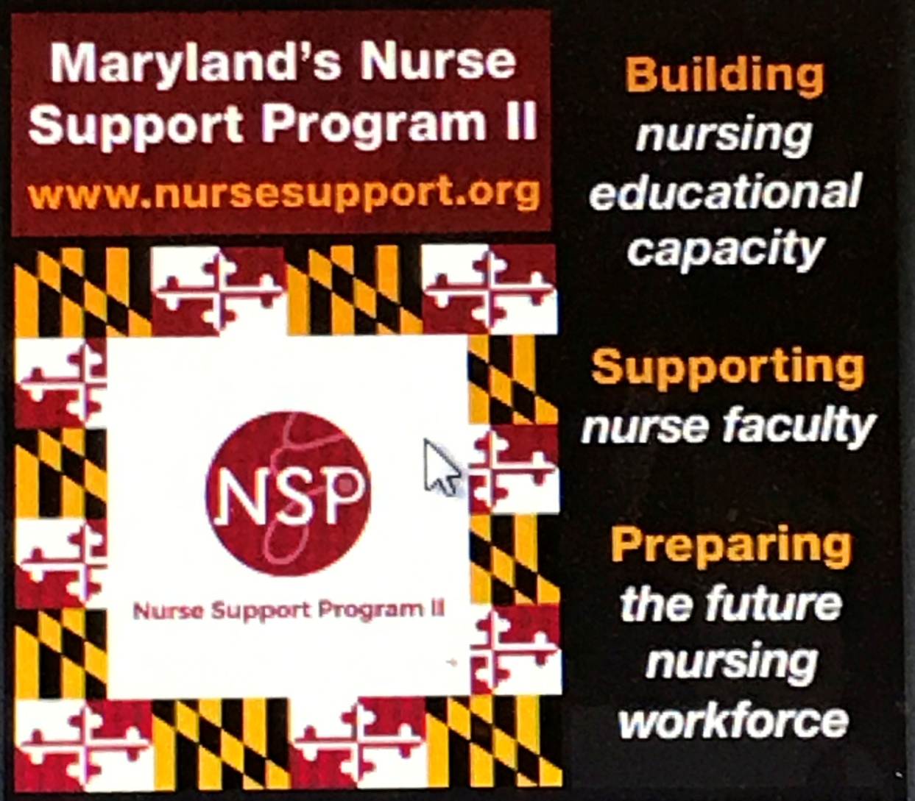
Maryland Nurses Association

Slide 21
National and State Conferences
Examples:
Sigma Theta Tau
AACN
NLN
NPAM
DNP
OADN and more
Posters and Podium presentations
Citations required with date/location/topic of
Presentation, along with a copy of materials
.

Slide 22


Academic Nurse Educator Certification (ANEC)
NSP II Requires
ACKNOWLEDGMENT
Rita F. D'Aoust, PhD, ANP-BC, CNE, FAANP, FNAP, FAAN
School of Nursing, Johns Hopkins University, Baltimore, MD, USA
abstract
results
This research evaluates one of the Nurse Support Program II’s (NSPII) outcomes for a state initiative to advance certification of nursing faculty.
Faculty reported chief barriers were uncertainty in eligibility, personal preparation burden, test anxiety, financial reimbursement and the investment required for the ongoing professional development requirements to maintain the credential.
ANEC Annual Award Incentive Outcomes by removing barriers, assisting personal strategies, and providing incentives
  131 faculty participated in CNE Examination reviews
  36 new CNE certifications and 21 CNE renewals in FY 2020
57 full time nursing educators received the ANEC Awards for new and continuing CNE certification
background
Research on CNE certification examination results (Byrne & Welch, 2016), and retrospective analysis of first- time unsuccessful attempts (Lundeen, 2018), identify exam preparation strategies, incentives, and rewards. Strategies and incentives include individually created timelines, formal direction from nursing education leadership and personal faculty investment.
Faculty reported chief barriers were uncertainty in eligibility, personal preparation burden, test anxiety, financial reimbursement and the investment required for the ongoing professional development requirements to maintain the credential.
To address these issues, the Maryland Council of Deans and Directors of Nursing Programs recommended the NSP II staff coordinate CNE Workshops in conjunction with the NLN Program Department.
References
conclusions
Altounji, D., Williams, S., & Secola, R. (2019). Inspire certification among pediatric hematology oncology nurses. Journal of Pediatric Oncology Nursing. https://doi.org/10.1177/1043454219845892
Barbé, T., & Kimble, L. P. (2017). What is the value of nurse educator certification? A comparison study of certified and noncertified nurse educators. Nursing Education Perspectives, 39(2), 66–72. https://doi.org/10.1097/01.NEP.0000000000000261
Barbé, T., & Kimble, L. P. (2018). A factor analysis of the perceived value of certification tool for nurse educators. Nursing Education Perspectives, 39(3), E2-E6. https://doi.org/10.1097/01.nep.0000000000000300
Byrne, M. M., & Welch, S. (2016). CNE certification drive and exam results. Nursing Education Perspectives, 37(4), 221–223. https://doi.org/10.5480/14-1408
Lundeen, J. D. (2018). Analysis of first-time unsuccessful attempts on the certified nurse educator examination. Nursing Education Perspectives, 39(2), 72–79. https://doi.org/10.1097/01.NEP.0000000000000276
Nurse Support Program II, Academic nurse educator certification (ANEC) award (2019). https://nursesupport.org/nurse-support-program-ii/grants/statewide-initiatives/academic-nurse-educator-certification/
Simmons, L. E. (2017). The NLN’s Certified Nurse Educator (CNE) Program Has Surpassed 5,000 and Gone Global. Nursing Education Perspectives, 38(2), 110. https://doi.org/10.1097/01.nep.0000000000000125
objectives
Develop incentive model and fund a new faculty focused grant program to facilitate new and maintenance of certification - the Academic Nurse Educator Certification (ANEC).
Evaluate outcomes based on the Perceived Value of Certification Tool for Nurse Educators (Barbé & Kimble, 2018)
The ANEC program (NSP II, 2019) has increased the number of faculty with the CNE credential and has increased the number of certified academic nurse educators in Maryland by 55%.
The ANEC program is a state initiative that demonstrates an increase in the number of certified academic nurse educators, provides formal recognition, facilitates preparation and maintenance, and provides financial incentives for new and continuing CNE certifications. An increase in intrinsic value is expected through individual accountability and pursuit of excellence as faculty achieve certification in their specialty area of practice.
Academic-State partnerships improve excellence in nursing education
methods
The Perceived Value of Certification Tool for Nurse Educators (Barbé & Kimble, 2018) used as a program evaluation framework for ANEC sample characteristics, certification out comes, program satisfaction, and a survey used to gather information on incentives, barriers, and personal strategies used by ANEC recipients on their certification journey.
The ANEC program was developed with and disseminated across 28 nursing programs in Maryland through:
  National League for Nursing approved CNE Examination workshops to Maryland educators
  ANEC incentive and recognition award
Conduct CNE Workshop surveys after each workshop
Conduct 3 CNE certification status surveys
acknowledgements
REMEMBER
Funding support provided by NSP II through the Health Services Cost Review Commission, administered by the Maryland Higher Education Commission
Maryland Council of Dean and Directors of Nursing Programs
Notes:
To change this poster, replace our sample content with your own. Or, if you'd rather start from a clean slate, use the New Slide button on the Home tab to insert a new page, then enter your text and content in the empty placeholders. If you need more placeholders for titles, subtitles or body text, copy any of the existing placeholders, then drag the new one into place.

Slide 23
Pick One*: Type and Initiative
*Type of Grant: ☐Planning ☐Implementation ☐Continuation ☐Resource Grant
*Type of Competitive Grant Initiative (choose only one):
☐1. Initiative to Increase Nursing Pre-Licensure Enrollments and Graduates
☐2. Initiative to Advance the Education of Students and RNs to BSN, MSN, and Doctoral Level
☐3. Initiative to Increase the Number of Doctoral-Prepared Nursing Faculty
☐4. Initiative to Build Collaborations between Education and Practice
☐5. Initiative to Increase Capacity Statewide
☐6. Initiative to Increase Cohen Scholars as Future Faculty and Clinical Educators

Slide 24
Key Items on Cover Sheet
Lead Applicant Institution/Organization: You
Project Title: Be brief ( 6 words or less)
Partnership Members: Include your hospitals and fellow nursing program partners
Project Duration: up to 4 yrs
Funding Requested: be realistic- $10mil/28
Value of Match (Funds, In-Kind, Etc.): Required
If projects submitted with -0- match and-0- in
Kind, there is no rationale or reason to help fund a
Project the school finds no value in.

Slide 25
Mandatory Data Tables
Nurse Support Program II FY 2022 – Competitive Institutional Grants
Mandatory Data Tables
Required Data Set for all Programs
Faculty: Calculate FTEs using the following formula: FTE calculation: 1 FTE = 15 credits or 600 hours per semester or as defined by your institution for Nursing Program Faculty as of October 15th of the most recent year.
NURSING FACULTY As of Oct. 15, 2020
Equivalents (Total FTEs)
FT
PT
Total Number
Nursing Faculty with PhD in Nursing
Clinical Nursing Faculty with MS Pg 48, RFA, FY 2022

Slide 26
Important: # graduates
# Graduates per academic year (as appropriate) Define AY reported: __________
ADN
BSN
Master Entry
RN-BSN
RN-MSN
MS
DNP
PhD
Graduates
We expect to see “additional graduates”. This is the baseline year and you will
propose increasing with the grant funding proposal.
RFA, FY 2022, Pg. 50

Slide 27
Person completing Data Tables
Note: The Dean/Director or designee already submits this information to the MBON and accrediting bodies each year. We expect it to match. Any questions, refer to your Dean/Director of the nursing program.
Name of person completing Mandatory Data Table Form:
_______________________________________________________________
Institution:
_______________________________________________________________
Contact Info:
Phone:
____________________________________________________________
Email address:
____________________________________________________________

Slide 28
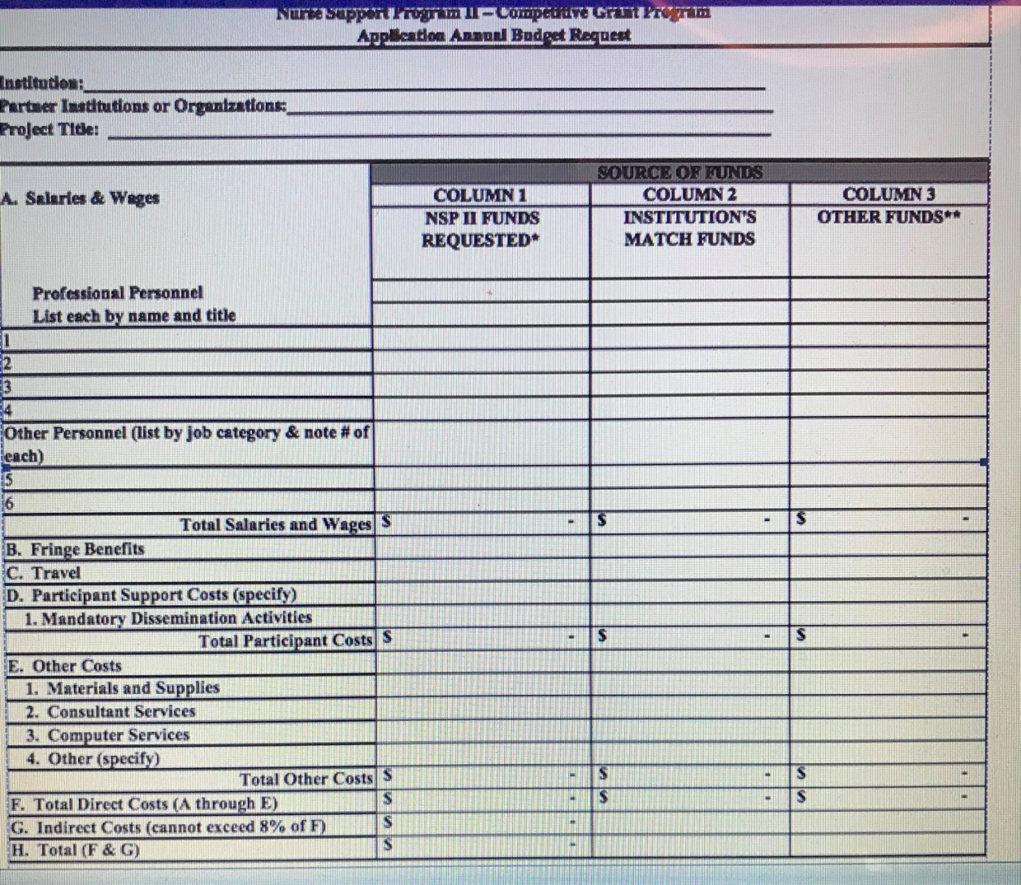
Budgets- annual and total years

Slide 29
Budget Narrative
SAMPLE BUDGET NARRATIVE ( annual reports should include narratives that match the proposal)
Nurse Support Program II – Competitive Institutional Grants
Lead Institution: _______________________________________________________
Project Title: __________________________________________________________
(These partial examples are provided only to demonstrate the format requested for the budget narrative. Provide as many sheets of paper as needed to provide justification for each line of the budget summary, as outlined in the RFA.) This is an annual and final report requirement. Please match proposal with future reports to ensure descriptions align.
Salaries & Wages
Professional Personnel:
Column 1: Dr. Jill Smith, the project director, will spend 10% of her time in project activities during the academic year. Maryland State University requests only the amount it will cost the university to pay an adjunct to replace Dr. Smith in one course. Request = $4,900
Column 2: The university will contribute the difference between the $4,900 requested and 10% of Dr. Smith’s 10-month annual salary as in-kind cost share valued at $3,100. Match = $3,100
Other Personnel:

Slide 30
Start with a tight budget
NSP II Review Panels WANT to fund as many of
the proposals as possible.
This past year, they added 8- but ONLY IF staff agreed
to work with the Project Director to cut the
Proposal budgets by up to 50%.
We did, but we will not agree to this in future.
If we can see where to cut your budget and the
Panel can see where there is excess, then you
can too. Don’t send it in, unless you want to
give up your chance to be funded. Excess budget
will disqualify your work just like late submission.

Slide 31
Annual and Final Reports
Reminders:
1. Projected/actual outcomes table matches original
2. Dissemination must be cited on pg. 2 right after the proposed/actual outcomes tables. Evidence of the submission- title of the poster/presentation on an agenda- copy of abstract/poster/letter included. Funding for dissemination is to be budgeted/spent every FY- not acceptable to be -0- in any budgets.
3. Send one report in one email from the Project Director, cc: others- with NSP II xx-xxx in subject line. PDF of annual w all forms & Excel spreadsheet of Annual Budget Summary
4. Submit a project & budget amendment form IF you are in the extension period-(the forms you used for extension are N/A for carryover- just an estimate- new forms required with annual report for use of funds as “carryover” to match the annual $$) or asking for eligible carryover (<$50K).

Slide 32
Carryover allowed < $50K
Situations where carryover is disallowed include:
Late reports without prior notification and written permission;
Overestimated the first year of the budget without hiring expected personnel in a timely manner;
Greater than $50,000 funds remaining at end of the fiscal year no carryover of any amount;
Did not submit required mandatory data tables;
Did not submit required annual mandatory dissemination citations and supporting materials, and
Project is not meeting proposed outcomes and has no likelihood of success either through overstating proposed outcomes or unexpected changes in the institution.
RFA Pg. 37

Slide 33
Excessive Carryover Guidance
With this FY 2022, we are in a new phase of NSP II with an additional 5-year renewal of funding FY 2021-2025. The recent issue of excessive carryover has been addressed through Technical Assistance and Project Director meetings, at personal Site Visits and in the annual RFA. See page 37 of the RFA under Grant Management/Fiscal Procedures/Post-Award Changes/ Carryover Process. After several meetings with the MHEC Finance Director, NSP II staff in conjunction with the HSCRC staff, NSP II is notifying all project directors that NSP II Project carryover greater than $50,000 will need to be returned this year.
Example: If funds in excess of $50,000 remain, those funds may be approved to remain at the school to begin your approved FY 2021 budget pending any additional funds for FY 2021. The annual reports are due 8/31. As soon as NSP II receives and approves your annual report, a formal letter describing the process and an invoice for the difference between the remaining funds on the report and expected FY 2021 payment will be released by MHEC. This will ensure projects continue uninterrupted and the funds are at the institution for the original approved FY 2021 budget. The carryover amount is deducted from the original award for FY 2021.
Ex: If less than $50,000 in funds remain, you must submit project and budget amendments to request the use of carryover funds in FY 2021. If approved, funds may be kept going into FY 2021.
Ex: If greater than $50,000 in funds remain, you will not be able to use any of them and a plan will be developed to deduct them from FY 2021 or leave them to be returned at the end of the grant due to the amounts.

Slide 34
Ineligible Costs new Proposals
Entertaining (excludes light fare or luncheons for faculty recruitment sessions, professional development sessions, conferences, etc.);
Existing programming that is fully funded;
Non-instructional equipment;
Clinical Simulation or Virtual Reality equipment, materials, supplies, PPE, high fidelity or other manikins;
Standardized patients;
Student funds for electronic resources or reimbursements for testing, ex: HESI, Kaplan, ATI, Nurse Tim, UWorld, Review Courses, licensure, and other student fees
Duplicating previously funded projects;
Construction and renovation of facilities; phone lines;
Furniture;
Capital equipment for new facilities;
Secondary school student programs;
Marketing;
Student retention/ academic success.
These are considered the responsibility of the institution. If required for the project,
put the amount of money you will use in the column for in-kind/ institutional match.

Slide 35
Grant Extensions
Grantees must also request written approval to extend the
expiration date of the grant if additional time beyond the
completion of the approved activity within the funds already
made available. A single extension, which shall not exceed six
(6) to twelve (12) months, may be made for this purpose and
must be requested no less than 1 month prior to the originally
established expiration date or May 31.
The request must explain the need for the extension and include
an estimate of unobligated funds remaining and a plan for use.
The fact that unobligated funds may remain at the end of the
Fiscal Year or at expiration of the grant is not in itself sufficient
justification for carryover or an extension.
If an extension is granted, include the letter with the annual report
and complete the project and budget amendment forms for carryover use

Slide 36
Availability of Funds
Return of funds process. Document in the annual report how the funds will be returned. All questions about funds transfer, transaction codes, tracking funding at the institution and detailed instructions about how to return any unused funds should be directed to MHEC’s Finance Director, Aubrey Bascombe at 410-767-3044, aubrey.bascombe1@maryland.gov.
Example: All electronic transactions for refunds for the NSP II Competitive Institutional Grants use. Agency R62; TC 412; AOBJ 1204
PCA 38203, $ of refund and NSP II Grant #, with Title
Document the date and amount of transfer or enclose a copy of the refund check sent to MHEC with the project number, title, Attention NSP II in the Annual/Final report
Note: Grant awards are subject to the availability of funds and not all eligible applicants may receive an award. The HSCRC has the option to rescind awards if funds are not available.

Slide 37
Think about Evaluation (2025)
Start with the end in MIND.
NSP II focuses on Graduates (you should too)
Personnel is the primary intent of NSP II $$$$.
Nurse Faculty to Teach
Clinical Nurse Instructors to Teach
Nurse grant managers to direct projects
Next priorities are: Faculty development, instructional technology, curriculum development, consultants, dissemination, etc.

Slide 38
NSP II Meetings for October, 2020
10/6/20
NSP II Virtual Site Visit
10-12 pm
OR
12-2 pm
10/16/20
NSP II Virtual Project Directors Meeting
10-12 pm
Or
12-2 pm
Staff will send you an invitation if you are due.
Project Director will send us a request to present.

Slide 39
References
Annotated Code of Maryland, Education Article § 11-405. Nurse Support Program Assistance Fund​​,​ [2006, chs. 221, 222.][2016].
Auerbach, D. I., Chattopadhyay, A., Zangoro, G., Staiger, D. O. & Buerhaus, P. I. (2017). Improving nursing workforce forecasts: Comparative analysis of the cohort supply model and the health workforce simulation model. Nursing Economics, 35(6), 283-326.
Health Services Cost Review Commission, https://hscrc.maryland.gov
Maryland Higher Education Commission, Nurse Support Program II, www.nursesupport.org

Slide 40
References
Zhang, X., Tai, D., Pforsich, H. & Lin, V. (2018). US registered nurse workforce report card and shortage forecast: A revisit. American Journal of Medical Quality, 33(3), 229- 236. https://edsource.org/wp-content/uploads/2019/02/Zhang-Daniel-Pforsich-Lin-2017- United-States-Registered-Nurse-Workforce-Report-Card-and-Shortage-Forecast_-ARevisit.pdf

Slide 41
Project Director’s Presentations
If time permits, we will allow 10-15 min for project directors to complete grant presentations for examples of dissemination to the group.

