Slide 1
Nurse Support Program II
Technical Assistance Meeting
NSP II Competitive Institutional Grants
Peg Daw, Maryland Higher Education Commission
Kim Ford, Maryland Higher Education Commission
Oscar Ibarra, Health Services Cost Review Commission
October 31, 2017
Charles I. Ecker Business Training Center
Columbia, Maryland

Slide 2
Nurse Support Program
Nurse Support Program I-
CNO’s -hospitals
Next Evaluation Due: 2022 ( renewed 2017)
Nurse Support Program II-
Deans/Directors- schools of nursing
Next Evaluation Due: 2020 (renewed 2015)
Common Goals
Common Funding Mechanism
Common Focus on Registered Nurses

Slide 3
Nurses: Most Trusted Profession
Strong public perceptions of nursing
The annual Gallup poll marks the 15th
consecutive year that nurses have been
ranked the most trusted out of a wide
spectrum of professions, including medical
doctors and police officers. (ANA, Dec.2016)
Assure quality of care
Protection and safety
Advice on personal health issue

Slide 4
RN-Shortages by 2025
STATE | 2012 Supply and Demand | 2025 Projected Demand | 2025 Projected Supply | Difference
Maryland | 60,600 | 72,000 | 59,900 | -12,000
West Virginia | 20,600 | 21,100 | 29,000 | +7,900
Delaware | 10,600 | 12,500 | 16,200 | +3,700
Virginia | 69,900 | 87,300 | 106,700 | +19,400
Pennsylvania | 145,000 | 152,600 | 178,400 | +25,800
US | 2,897,000 | 3,509,000 | 3,849,000 | +340,000 (HRSA, 2014)

Slide 5
US Population is Growing & Aging
According to the U.S. Census Bureau,
between 2010 and 2050, the U.S. is
projected to experience rapid growth in its
older population.
In 2030, when all of the baby boomers will be
65 and older, nearly 1 in 5 U.S. residents will
require healthcare
The 85 and older population is expected to
more than triple, from 5.4 million to 19 million
between 2008 and 2050.

Slide 6
1,000,000 RNs are Retiring
One million RNs will be retiring over next 10 years (2017-2027)
One-third of the RN workforce
Millions of years of nursing experience leaving the workforce each year
Nurse Faculty retiring impacts educational capacity for new RNs
(Buerhaus, Auerbach, & Staiger, 2017)

Slide 7
Big Picture: Relationships Key
It’s the Right Time and a
Good Time to Reset Strategic
Relationships
1. With nurses, physicians, community and organization
2. To ensure an adequately sized, well-configured, and well prepared nursing workforce
3. Capable of meeting challenges that lie ahead (Buerhaus,2017)

Slide 8
Strengths of the Nursing Workforce
From the Nursing Profession’s Perspective
(2000-2015)
1. Increasing education, steady employment growth, RN compensation better than most
2. Hospitals have linked value to BSN prepared RNs
3. Increasing numbers of RNs through 2030, enough to replace retirement of baby boom RNs
4. Increasing evidence of positive contributions of primary care nurse practitioners
5. Strong public perceptions of nursing, increasing influence in health policy (Buerhaus, 2017)

Slide 9
Dramatic Growth in RN Graduates
2002- 2014
Number of new RN graduates more than
doubled from 77,000 in 2002 to over
200,000 in 2014
Broad based, rapid growth
All demographic groups (Men, Hispanics, African Americans)
In baccalaureate and associate degree programs
In private and public institutions
And especially in private for-profit schools
(Buerhaus, Auerbach, Staiger, 2014)

Slide 10
Dip in Graduates 2012-2016
Presented MHEC Graduate Data to Deans/Directors
April 21, 2017
Catonsville, MD
The Associate Degree in Nursing Programs have seen a
13% reduction over 5 years in graduates.
18% increase over 5 years in graduates.
Confounder:
MHEC ( using IPEDS) does not track RN-BSN separately.
683 of the 1815 in 2016 were RN-BSN, thus only 1132 new BSNs
It is estimated that Maryland will have 3450 new RN job openings per
year to 2025. This year (2016) we graduated 1132 + 1537 + 44 = 2713

Slide 11
Maryland new AD in Nursing RNs
2012 Associate Degree 1738
2013 1726
2014 1626
2015 1625
2016 1537
Idea- increase cohorts or # accepted

Slide 12
MS Direct Entry- new RNs
Second Career- admitted with a BS
degree in another field
University of Maryland
Grads ranged 44-109 annually
Johns Hopkins University
Building back to ~~290/ Yr. new MS entry RNs ( BSN program closed-MS entry program start- in transition = dip in grads)
Does anyone have a BS second career
entry to BSN? ( idea)

Slide 13
Latest Supply Projections: 2017-2030
Highlights:
Nationally, able to replace the retiring baby
boom RNs as total national supply will
increase by roughly 1 million RNs
The Feds believe this growth will be enough
to match the demand for RNs, at least on a
national basis. ( Remember- we are 1 of the 16
states projected to have nursing shortage)
(Auerbach, Staiger & Buerhaus, 2017)

Slide 14
The RN Shortage is Real
Nurse supply and demand forecasts project nurse
shortages into 2025 and worsening into 2030 in key
states- including Maryland.
U.S. Bureau of Labor Statistics reporting a need for
233,000 additional RNs just in each of the next 2 years.
Misleading impression of an evaporated shortage or
that there has been a growth in the RN workforce
sufficient to meet all needs created by 574,400 new
jobs as 26.3% of 555,100 eligible RNs delayed
retirement creating a false sense of complacency.

Slide 15
Lag in Graduates to fill Jobs
“…300,000+ won’t be filled when timed with graduation trends…” according to the American Journal of Medical Quality, while Georgetown University project’s the shortfall to be 193,000 by 2020.
Juraschek, Zhang, et al. forecast a shortage of 918,232 by 2030, ranging from 725,619 to 1,112,112.
The 16 highest forecasted RN shortage states by 2030 ----include Maryland!

Slide 16
Nursing Workforce Researchers
Douglas Staiger, David Auerbach and Peter Buerhaus, pointed out that “…the substantial expansion in the RN workforce is a temporary bubble that will deflate during the next several years…as the RNs…in the workforce withdraw as unemployment rates fall…and this will occur simultaneous to a wave of RN retirements…contributing to lower levels of RN workforce growth.”
RNs are going part-time, retiring or exiting the workforce- such that the shortage will be even more severe than prior to the recession

Slide 17
RN Shortage 19% by 2020
BLS estimating 555,100 will retire by 2022.
During the recent recession 26.3% of these RNs delayed retirement.
Between 2013–2015, 37% of the nurses became retirement eligible, with another 7% in 2016
Of this 44% retirement eligible, 32% are considering retirement in 1-year or less and 47% in the next 3-years,
Just as baby boomers are increasing healthcare consumption– RNs are leaving

Slide 18
Minimizing the Effects of the Shortage
Nurse recruitment will be at a faster
pace in 2016 and 2017 as a healthier
economy and a shrinking uninsured
population with aging baby boomers.
The key questions are: How do hospitals prepare? How do they recruit and retain? Reduce turnover? Hospitals depend on the nursing education system to supply RNs.

Slide 19
Nursing Faculty Needed
According to the American Association of Colleges of Nursing (AACN), the
reasons for rejecting 64,067 qualified applicants included: (1) insufficient
number of faculty, (2) a lack of classroom space/ clinical sites, (3) insufficient
preceptors and (4) budget cuts.
BLS projects a 35% faculty increase needed to meet demand.
This is compounded by1,567 current faculty Vacancies and 133 additional
positions needed to meet student demand (AACN) and by the 10,200 (44%)
faculty expected to retire and against the 20% faculty planning to go part time,
translating to 34,200 additional faculty needed by 2022.
National 2016 faculty vacancy rate (AACN): 7.9%
Maryland 2016 faculty vacancy rate: approx. 3.51% (CC) 11.72% (Univ)

Slide 20
RN Jobs outpacing Graduates
Between 2012- 2016 an estimated 233,000 new RN jobs
were created annually, but there were only an average 155,000
new nurse graduates, and only an average 140,000 passed the
NCLEX-RN nationally
2016 ( 161,156 new RN grads with 135,276 first time testers passed)
83.94% national pass rate
2016 MD (2759 new RN grads with 2285 first time testers passed)
82.82% Maryland pass rate (MBON, 2017)
Rising demand for APRNs that will draw off another 198,000 RNs.
Consider the 1,000,000 million nurses projected to retire in 10 yrs.

Slide 21
Tipping Point- BSNs outpace ADNs
The nation’s nursing workforce has reached a critical tipping point to meet the IOM goal for 80% BSN or higher degrees.
By 2012, more nurses (53 percent) were earning four-year baccalaureate than two-year associate degrees (47 percent).
The percentages were mirror opposite images of each other a decade earlier; in 2002, (55 percent ) nurses earned an ADN and (45 percent) earned a BSN.
A strong driver of the change is an explosion of accelerated Registered Nurse (RN)-to-BSN nurse education programs, which enable RNs and nursing students to earn bachelor’s degrees in shorter time periods than do traditional four-year BSN programs.
( Aurbach, Buerhaus, Staiger, 2016)

Slide 22
APIN- RWJF Program Concludes
Academic Progression
In Nursing
“We have not found
a perfect model-
one size does
NOT fit all” RWJF Conference
Nov. 2016
RWJF no longer funding nursing workforce projects- shifted to “culture of health”
The Academic Progression in Nursing Program (APIN) has concluded a four-year project to identify and develop the most promising strategies for creating a more highly educated nursing workforce. APIN was funded by the Robert Wood Johnson Foundation (RWJF) in partnership with the nursing Tri-Council, and was administered by the American Organization of Nurse Executives (AONE).

Slide 23
National Education Progression in Nursing Collaborative (NEPIN)
The National Education Progression in Nursing Collaborative (NEPIN) has hired Tina Lear as National Program Director to accelerate educational advancement for nurses across the United States.
If you would like more information or would like to be involved, contact Tina Lear tina.lear@nepincollaborative.org.
Donna Meyer ( CEO, OADN)
Christy Dryer ( President, OADN)
Bryan Hoffman (Deputy Director, OADN)
NEPIN is new, but the organization’s continued work emanates from the APIN (Academic Progression in Nursing) initiative, a grant-funded effort of the Robert Wood Johnson Foundation (RWJF) that concluded in June.
The Organization for Associate Degree Nursing (OADN) Foundation will serve as the fiduciary and convener for the collaborative.
Nancy Perry provided update at NSP II APIN mtg. 10/11/17

Slide 24
Associate Degree RNs Needed
Our results indicate, as did Kovner and colleagues(2014), ADN-prepared RNs appear to be
experiencing diverging labor market outcomes from BSN-prepared RNs.
Yet, at the same time, there has been a rapid increase in ADN educational programs
over the last 10 years. This growth may be helping to fill what would otherwise be a
potential new nursing shortage as the baby boomer RNs begin to exit the
workforce? ( Remember- they are looking at national nursing workforce changes- in
Maryland we saw static programs with a reduction in ADN graduates over last 5 yrs.)
Even if ADN-prepared RNs are not always finding the hospital positions some of
them expect upon entering nursing school, the widespread availability of RN-to-
BSN programs provides a relatively easy step for conversion to a BSN.
( Auerbach, Buerhaus, Staiger, 2015)

Slide 25
Faculty-Focused Strategies
Double the number of RNs with Doctoral Degrees
( PhD in Nursing/Other, Doctor of Nursing Practice, EdD)
Barriers- Money and Time
( NSP II- Hal and Jo Cohen GNF- Full Tuition at any State
School graduate degree program, New Nurse Faculty
Fellowships (NNFF) for $20K over 3 years and Nurse Educator Doctoral
Grants for Practice and Dissertation Research (NEDG) to
Faculty for up to $30K)
Mentorship- Early career guidance
Dual Roles- Academia and Practice
Certified Nurse Educators (CNE) symbolizes excellence in education- increasing faculty credentials

Slide 26

FY 2018 New Nurse Faculty Fellowships
13 Nursing Programs nominated 46 New Nurse Faculty
30 from Universities
16 from Community Colleges
All were eligible
All were awarded $20K over 3 yrs. ($10K year one, $5K year two and three with continued employment)
NNFF 89% retention
Successful program
Open to all SON Deans/ Directors

Slide 27
Nurse Graduates are the NSP II Competitive Institutional Grant’s Priority
“Nurses should achieve higher levels….through an improved education system that promotes seamless academic progression….education should include opportunities for seamless transition into higher degree programs….”
From licensed practical nurse (LPN)/ licensed
vocational nurse (LVN) diplomas; (idea)
To the associate’s (ADN) and bachelor’s (BSN)
degrees; To master’s, PhD, and doctor of nursing
practice (DNP) degrees.
(IOM, FON, 2010)

Slide 28
Findings for a Nurse Residency
Findings indicated a nurse residency program was associated
with a decrease in the 12-month turnover rate from 36.1% to
6.4% and a reduction in contract labor usage from $19,099 to
$5,490 per average daily census.
These cost-benefits suggest net savings between $10 and $50
per patient day when compared to traditional methods of
orientation.
Immediate ROI without any additional ancillary costs,
amounting for every 20 travel nurses eliminated an
average to $1,430,000 net of the cost of the employed
RNs hired to replace the travel nurses.

Slide 29
NSP I and NSP II are Investments
NSP I
Maryland Nurse Residency Consortium
The residency programs offer a cost-effective
innovative approach and should be valued as
an investment as opposed to an expense.
NSP II
The nursing education faculty and nursing
program capacity should offer cost-effective
and innovative approaches to HSCRC’s
investments intended to graduate additional
RNs and recruit/retain additional Faculty.
Idea – Offer an ROI for proposals

Slide 30
SB 108-”bedside”deleted
Introduced during the 2016 Maryland legislative session with the purpose of deleting the term “bedside” from the descriptor of nurses in the statutory provision establishing the NSP II
Instead of focusing on “bedside” nurses, SB 108 allows the NSP II to improve the pipeline of nurses with the skills necessary to keep pace with the rapidly changing health care delivery system. It was passed by both the Maryland Senate and the House and approved by the Governor on April 26, 2016.
RFA pg. 5

Slide 31
FY 2019 RFA Timeline
NSP II Competitive Institutional Grants
RFA Released October 11, 2017
Technical Assistance October 31, 2017
PROPOSALS DUE January 26, 2018
HSCRC Draft May, 2018
HSCRC Final Approvals June, 2018
FY 2019 Projects Begin July 1, 2018

Slide 32
Initiatives FY 2015-2020
Type of Competitive Grant Initiative:
☐1. Initiative to Increase Nursing Pre-Licensure Enrollments and Graduates
☐2. Initiative to Advance the Education of Students and RNs to BSN, MSN, and Doctoral Level
☐3. Initiative to Increase the Number of Doctoral prepared Nursing Faculty
☐4. Initiative to Build Collaborations between Education and Practice (new nursing roles-pt. care continuum)
☐5. Initiative to Increase Capacity Statewide
RFA Pg. 10-13
Remember: Priorities in Year 4 & 5 are #1 & 2

Slide 33
Grant Outcomes
Final Outcomes /Projected Increase
(# of Additional Graduates)
Describe Degrees/Results
Nursing Pre-Licensure Graduates __________
Nursing Higher Degrees Completed _________
Nursing Faculty at Doctoral Level __________
Collaborative or Statewide Results __________
Appendix A Cover Sheet
RFA,Pg.30

Slide 34
Types of Grants-Funds
Funding Requested: _______
Value of Match (Funds, In-Kind, Etc.): __***
Type of Grant:
☐Planning ( 1-2 years)
☐Implementation (1-3 years)
☐Continuation (Invitation only)
☐Statewide Capacity
☐Resource Grant (Up to $50,000 1 yr.)

Slide 35
Planning Grants
Planning projects cover up to 2 yrs of funding. Planning grants award up to $150,000 for planning the projects that align with the goals of the NSP II.

Slide 36
Implementation Grants
NSP II Implementation grants are available for projects that will (1) increase the enrollment and graduation of nurses who will then practice in Maryland hospitals and/or (2) increase the supply of qualified nursing faculty required to expand the capacity of Maryland’s nursing programs. Implementation grants have no maximum grant award amounts. However, the budget must be justified by the scope and outcomes of the project. Grants will be funded for a period of one (1) to three (3) years to produce graduates

Slide 37
Continuation Grants
NSP II Continuation Grants are available for successful grant projects that are recommended for funding beyond the initial grant period to expand on models or programs that have potential for greater impact with additional funding.
Continuation grants are only available for projects invited to apply.
Invitations to continue will be sent out in the last year of the grant. If a continuation is not recommended, you may still reapply for similar programs if desired.

Slide 38
1 yr.-Resource Grants
Statewide resource grants award up to $50,000 for small projects that align with the goals of the NSP II but would not qualify as implementation or planning grants. Initiatives that qualify under this program are short-term (up to 12 months) in nature. Past uses have been accreditation support, responding to MBON plans, software to track clinical students, faculty professional development and clinical simulation equipment.
These grants support a wide-range of eligible expenditures. Proposed expenditures that (1) add overall value to the nursing program, (2) lack alternative funding sources, and (3) are not considered ineligible expenses
Clinical Simulation Equipment Requests redirected to:
Simulation Equipment Request DUE 12/1/17 – at
file:///C:/Users/pdaw/Downloads/Request%20for%20Equipment%20and%20Material%20Updated%2010.18.17.pdf
See MCSRC for Train the Trainer DUE 11/15/17 at https://cms.montgomerycollege.edu/EDU/Department.aspx?id=84094

Slide 39
Statewide Capacity
The NSP II policy is to ensure intellectual property developed in the course of or under this grant to increase statewide capacity furthers the goals of the NSP II and benefits the nursing profession in Maryland. This policy applies to all grants awarded funding under Initiative 5, Initiatives to Increase Capacity Statewide as identified on the cover sheet of the grant proposal. The NSP II Intellectual Property Policy is as follows:
By accepting these grant funds, the grantee agrees that:
a. The grantee shall deliver a complete, functioning version or copy of the final products developed under the Grant to the Health Services Cost Review Commission (HSCRC) and Maryland Higher Education Commission (MHEC).

Slide 40
What should you think about first?
Future funding is determined by program outcomes.
Insert Initiatives
Insert Outcomes Table
Provide brief (5 slide) PPT with highlights
FOCUS- address nursing program needs and intended outcomes in the first two pages of the proposal.
*** MBON NCLEX-RN pass rates below state levels or CCNE/ACEN Accreditation review concerns come first and are appropriate requests through 1 yr. Resource grants.

Slide 41
NSP II Grant Funds Past Uses
Nurse Faculty ****** #1 use of funds
Nursing Program adjuncts, clinical, coordinators & simulation personnel
Professional Development
Instructional Delivery
Curriculum Redesign
Materials and Teaching Supplies
Mandatory Dissemination
Consultants
Technology
Evaluation

Slide 42
Grant Title and Requestors
Lead Applicant Institution/Organization:
School of Nursing at____________
Project Title:
Brief & Descriptive ( 6 words, please)
Partnership Members: ****
****This is an important aspect.
Remember- MRNC has 20 hospitals partnering with nurse residency programs.

Slide 43
Evaluation Criteria
Criteria Maximum Points
Abstract & PPT 5
Overview 15
Project Goals and Objectives 15
Scope of Proposed Initiative 15
Management Plan 15
Evaluation Plan 15
Budget and Cost Effectiveness 20
Total 100

Slide 44
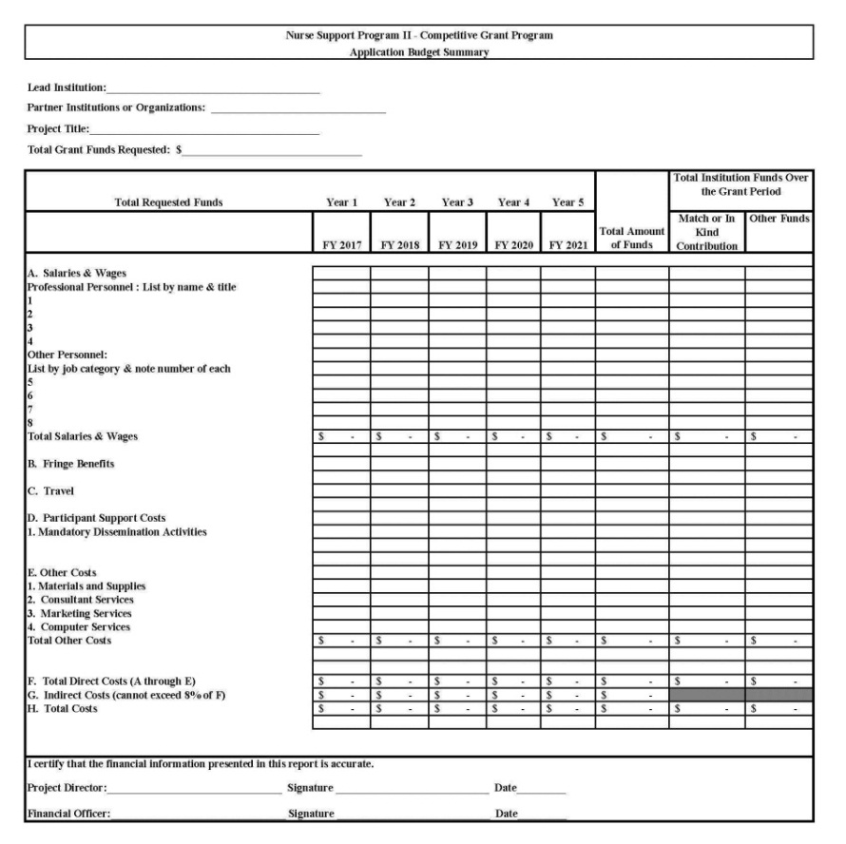
Budget Guidance
Application Budget Summary
Budget Pointers
Accuracy: Check and Double Check Figures
Fringe Benefits: Ensure the Cost Allocated for Fringe Benefits is Reasonable
Budget Narrative: Ensure Budget and Budget Narrative Match
Do not include annual increase in salary over future years if the State of MD is on ZERO increase the year you submit.

Slide 45
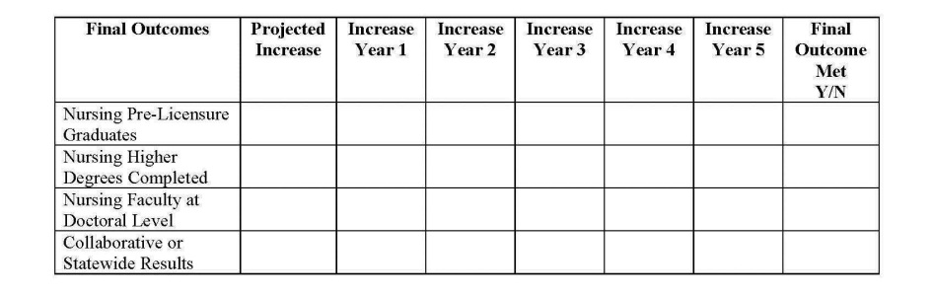
Annual Reporting
Changes
Projected Outcomes Table from Cover Sheet in Appendix A
Due Date: August 31st
Budget Summary: Actual Expenditures
Annual Report: Projected Outcomes & Dissemination Sections
Every project funded since 2015, must include information on dissemination
Carryover: Linked to Performance and declined if nearing $100K. In year adjustments to meet goals expected of all PIs.

Slide 46
Mandatory Data Tables
The same information is provided to the Maryland Board of Nursing and the Nursing Program Accreditation Agencies
Use October 15 for enrollments and faculty
Use the most recent Academic Year for graduates
Identify person completing forms
Appendix A
Required for initial Proposal
Required Annual Reports
Required Final Reports
If a school intends to increase graduates in the proposal, the outcomes should be reflected over time in these tables, as well as reported in interim and final reports.

Slide 47
Needed: Data and Research
Results =Met or Did Not Meet proposed outcomes
Documentation of project results
Dissemination of publications
Shared resources for nurses
Annual and Final Reports- Mandatory Data
Highlighting Faculty Awards
Annual Updates on NSP II to HSCRC
Nursing Education and Workforce Research
Nursesupport.org - website

Slide 48
FY 2019- Proposals w 8 copies
ALL PROPOSALS ARE DUE:
January 26, 2018
Friday by 4 pm
Maryland Higher Education Commission
6 N. Liberty Street, 10th floor
Baltimore, Maryland 21201

Slide 49


Slide 50
References
AACN (2017) Nursing Faculty Shortage Fact Sheet
http://www.aacnnursing.org/Portals/42/News/Factsheets/Faculty-Shortage-Factsheet-2017.pdf
ANA (2016) Nurses rank #1 most trusted profession 15 years in a row, http://www.nursingworld.org/FunctionalMenuCategories/MediaResources/PressReleases/2016-News-Releases/Nurses-Rank-1-Most-Trusted-Profession-2.pdf
Auerbach, D.I., Buerhaus, P.I., and Staiger, D.O. (2016). How fast will the registered nurse workforce grow through 2030? Nursing Outlook; 0,1-7.

Slide 51
References
Health Services Cost Review Commission (HSCRC)
www.hscrc.state.md.us
Institute of Medicine (2010) Future of Nursing Report, ch.3, pg.123. https://www.nap.edu/read/12956/chapter/8#123
Maryland Higher Education Commission (MHEC)
www.mhec.state.md.us
Nurse Support Program, www.nursesupport.org
Competitive Institutional Grants FY 2019 RFA
http://www.nursesupport.org/nurse-support-program-ii/grants/competitive-institutional-grants
National Education Progression in Nursing Collaborative, N-OADN, https://newswise.com/articles/nepin-appoints-tina-lear-as-national-program-director

Slide 52
References
Rajkumar, A., Murphy, K. Colmers,J., Blum, J., Conway, P. & Sharfstein, J. (2014). Maryland’s all-payer approach to delivery-system reform. New England Journal of Medicine, 370, 493-495. http://www.nejm.org/doi/citedby/10.1056/NEJMp1314868#t=article#t=citedby
U.S. Department of Health and Human Services, Health Resources and Services Administration, National Center for Health Workforce Analysis. (HRSA) The Future of the Nursing Workforce: National- and State-Level Projections, 2012-2025, Rockville, Maryland; 2014.
https://www.nh.gov/nursing/forms/documents/hrsa-report-nursing-projections.pdf
Juraschek, S., Zhang, X., et. al.(2012). United States registered nurse workforce report card and shortage forecast, American Journal of Medical Quality, 27(3); 241-249, https://www.ncbi.nlm.nih.gov/pubmed/22102163
U.S. Department of Commerce, Bureau of the Census, 2015 American Community Survey; ranking excludes Washington, DC., as cited by the Maryland Department of Commerce. Accessed on October 30, 2017:
http://commerce.maryland.gov/about/rankings-and-statistics

Slide 53
Workforce Resources
ANA, RN Retirements Tsunami Warning http://www.ananursespace.org/browse/blogs/blogviewer?BlogKey=398c2049-1b0d-405e-b065-0b0cea4eec59&ssopc=1
Buerhaus, Auerbach, & Staiger, May 3, 2017. hbp://healthaffairs.org/blog/2017/05/03/how-should-we-prepare-for-the-waveof-retiring-baby-boomer-nurses/
Auerbach, Staiger, & Buerhaus (2017 in press). Millenials are almost twice as likely to choose a nursing career as were the baby boomers, but workforce growth is decelerating. Health Affairs

Slide 54
Workforce Resources
Auerbach, D.I., Buerhaus, P.I., and Staiger, D.O. (2015). Will the RN workforce weather the retirement of the baby boomers?Medical Care; 53: 850–856.
Auerbach, D.I., Buerhaus, P.I., and Staiger, D.O. (2014) Registered nurses are delaying retirement, a shift that has contributed to recent growth in the nurse workforce. Health Affairs; 33: 1474–1480.
Auerbach, D.I., Buerhaus, P.I., and Staiger, D.O. (2007)Better late than never: Workforce supply implications of later entry into nursing. Health Affairs; 26: 178–185.
Auerbach, D.I., Staiger, D.O., Muench, U., and Buerhaus, P.I. (2013)The nursing workforce in an era of health care reform. New England Journal of Medicine; 368: 1470–1472.
Buerhaus, P.I., Auerbach, D.I., Staiger, D.O., and Muench, U. (2013)Projections of the long-term growth of the registered nurse workforce: A regional analysis. Nursing Economics; 31: 13–17.

Slide 55
Workforce Resources
Auerbach, Buerhaus, & Staiger (2016). How Fast Will the RN Workforce Grow through 2030? Projections in Nine Regions of the Country. Nursing Outlook, Nov 22, 2016
Buerhaus, Skinner, Auerbach, & Stagier. Four challenges facing the nursing workforce in the US. Journal of Nursing Regula9on (2017 in press)

Slide 56
Workforce Resources
Auerbach, D., Buerhaus, P., Staiger,D. (2015). Do associate degree registered nurses fare differently in the nurse labor market compared to baccalaureate prepared RNs? Nursing Economics. 33(1), 8-14, 35.
https://www.nursingeconomics.net/ce/2017/article33010835.pdf
Buerhaus, P. (2017). Strengths of the Nursing Workforce and Challenges Nurses and the Health Organiza9ons that Employ them will Face Over the Next 10 Years. Missouri Hospital Association, June 15, 2017, accessed
https://web.mhanet.com/Leadership%20Forum/2017/Buerhaus.pdf

Slide 57
Workforce Resources
Buerhaus, P, Auerbach, D., Staiger. D.(2014) The rapid growth of graduates from associate, baccalaureate and graduate programs in nursing. Nursing Economic$. 32(6), 290-295, 311.
https://www.ncbi.nlm.nih.gov/pubmed/26267959
Buerhaus, P. Retchin, S. The Dormant National Health Care Workforce Commission Needs Congressional Funding To Realize its Promise. Heath Affairs (November 2013).

Slide 58
Donelan, Buerhaus, DesRoches, Burke,(2010). Health Policy Thoughtleaders Views of the Health Workforce in an Era of Health Reform. Nursing Outlook. 58(4): 175-180.
DesRoches, C, Buerhaus, P, Dibus, R, Donelan, k. (2015). Primary Care Workforce Shortages and Career Recommendations from Practicing Clinicians. Academic Medicine. 90(5): 671-677. 12.
Auerbach, DI, Chen, PG, Friedberg, MS, Reid, R, Lau, C. Buerhaus, PI, Mehrotra, A. (2013). Nurse-managed health centers and patient-centered medical homes could mitigate expected primary care physician shortage. Health Affairs 32(11):1933-1941.

Slide 59
Workforce Resources
Buerhaus, P., Staiger, D., and Auerbach, D. (2009). The future of the nursing workforce in the United States: Data, trends and implications. Jones & Bartlett Publishers, Boston, MA.
Petterson, S.M., Liaw, W.R., Phillips, R.L. Jr., Rabin, D.L., Meyers, D.S., and Bazemore, A.W. (2012).Projecting US primary care physician workforce needs: 2010-2025. The Annals of Family Medicine; 10:503–509.
Siow, E. and Ng, J. (2013). Internal migration of nurses in the United States: Migratory prompts and difference in job satisfaction between migrants and non-migrants. Nursing Economics. 2013; 31: 128.
Spetz, J. Too many, too few, or just right? Making sense of conflicting RN supply and demand forecasts. (2015). Nursing Economics; 33: 176.

Slide 60
Workforce Resources
Maryland Residents: Maryland Department of Planning, Table 2, Estimates of the Resident Population by Race and Hispanic Origin for the United States and States, 7/1/2014,
http://planning.maryland.gov/msdc/pop_estimate/estimate_10to14/HighlightSection/table2.pdf
Maryland Higher Education 2017 Databook. Accessed on October 30, 2017:
http://mhec.maryland.gov/publications/Documents/Research/AnnualPublications/2017DataBook.pdf
U.S. Department of Labor, Bureau of Labor Statistics, 2014 Geographic Profile of Employment and
Unemployment; ranking excludes Washington, DC., as cited by the Maryland Department of Commerce. Accessed
on October 30, 2017: http://commerce.maryland.gov/about/rankings-and-statistics
U.S. Department of Labor, Bureau of Labor Statistics, Employment and Wages, Annual Averages 2015; U.S.
Department of Commerce, Bureau of the Census; ranking excludes Washington, DC., as cited by the Maryland
Department of Commerce. Accessed on October 30, 2017: http://commerce.maryland.gov/about/rankings-and-
statistics
U.S. Census Bureau, 2011-2015 American Community Survey 5-Year Estimates. Accessed on October 30, 2017:
https://factfinder.census.gov/faces/tableservices/jsf/pages/productview.xhtml?pid=ACS_15_5YR_S1501andprodType=table

